Slide 2
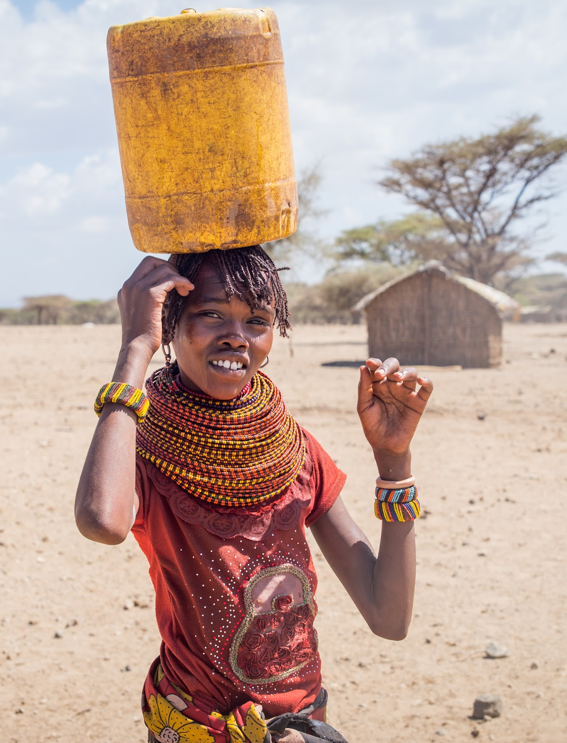
THE GLOBAL WATER CRISIS
1 billion people lack access to clean water
Women & girls are responsible for water collection in 80% of households
Most walk 3.5 miles on average to collect water
(United Nations)
(United Nations)

Slide 3
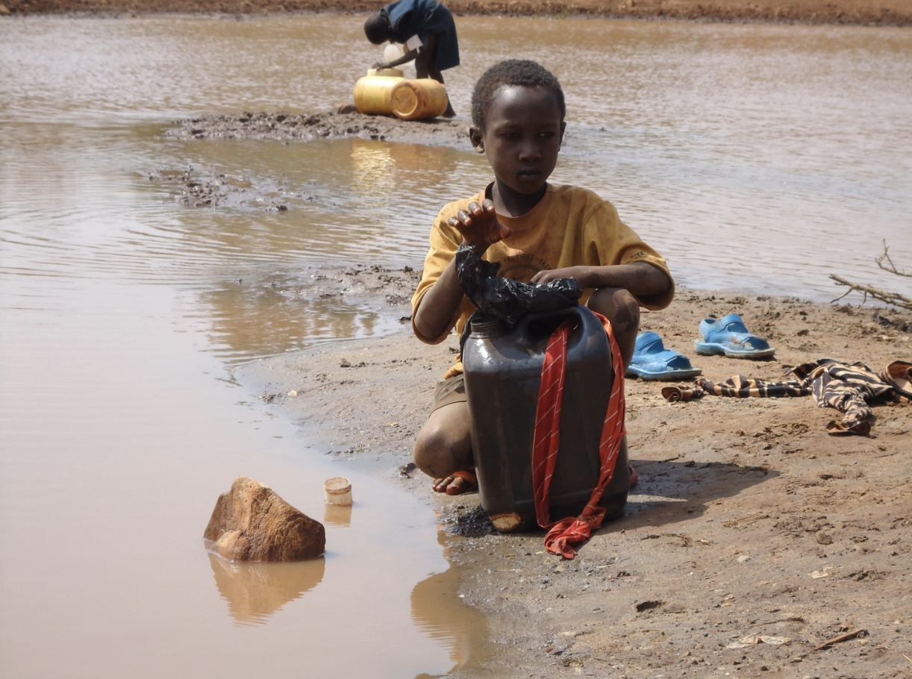
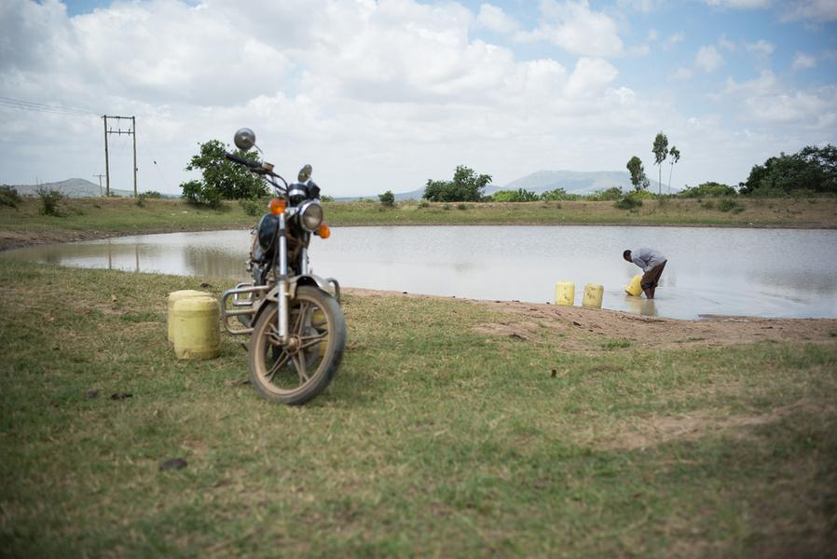
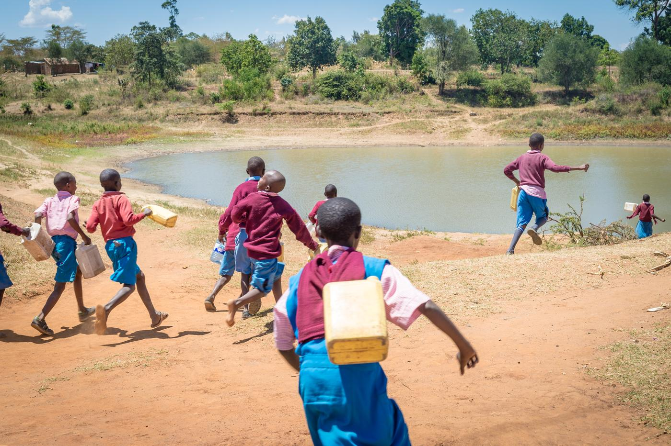
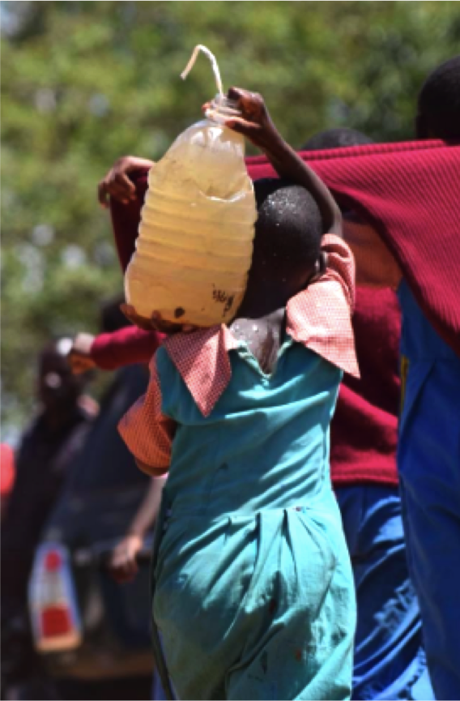
159 million collect untreated water from lakes, ponds, rivers and streams.
(WHO)

Slide 4
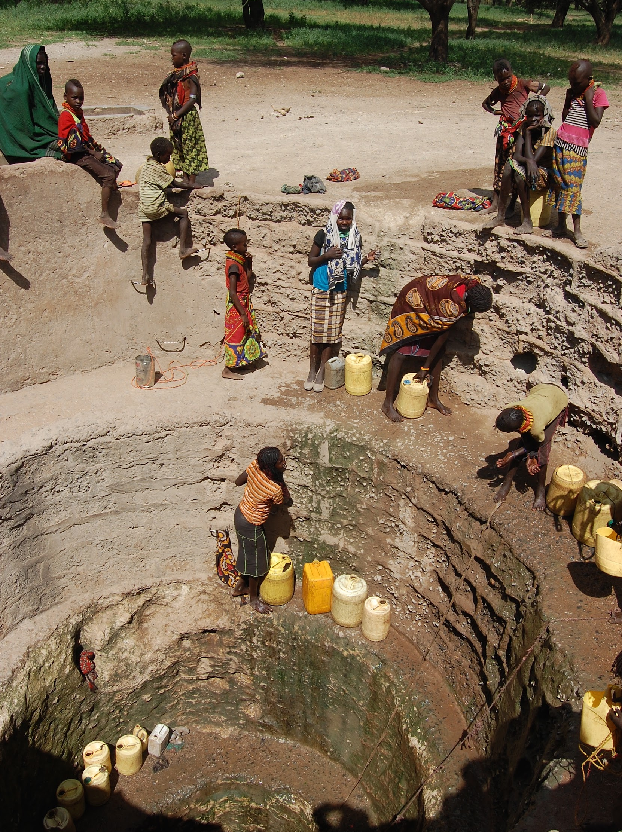
Others collect water from dangerous, contaminated step wells like this.

Slide 5
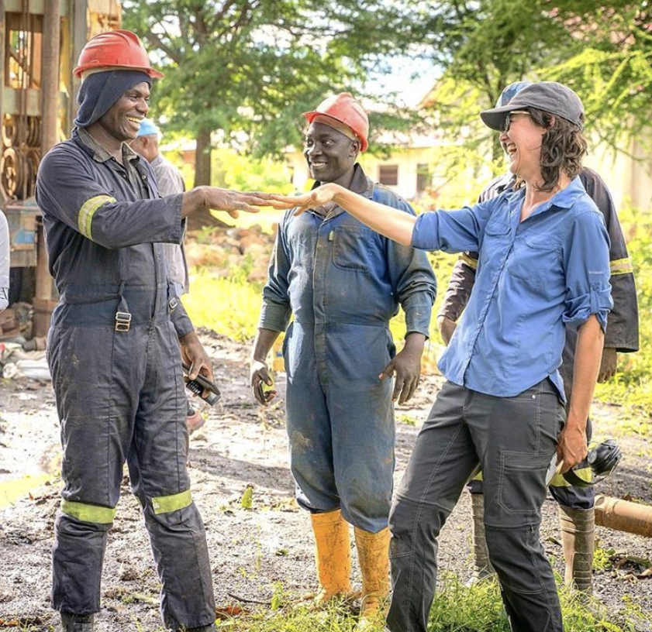
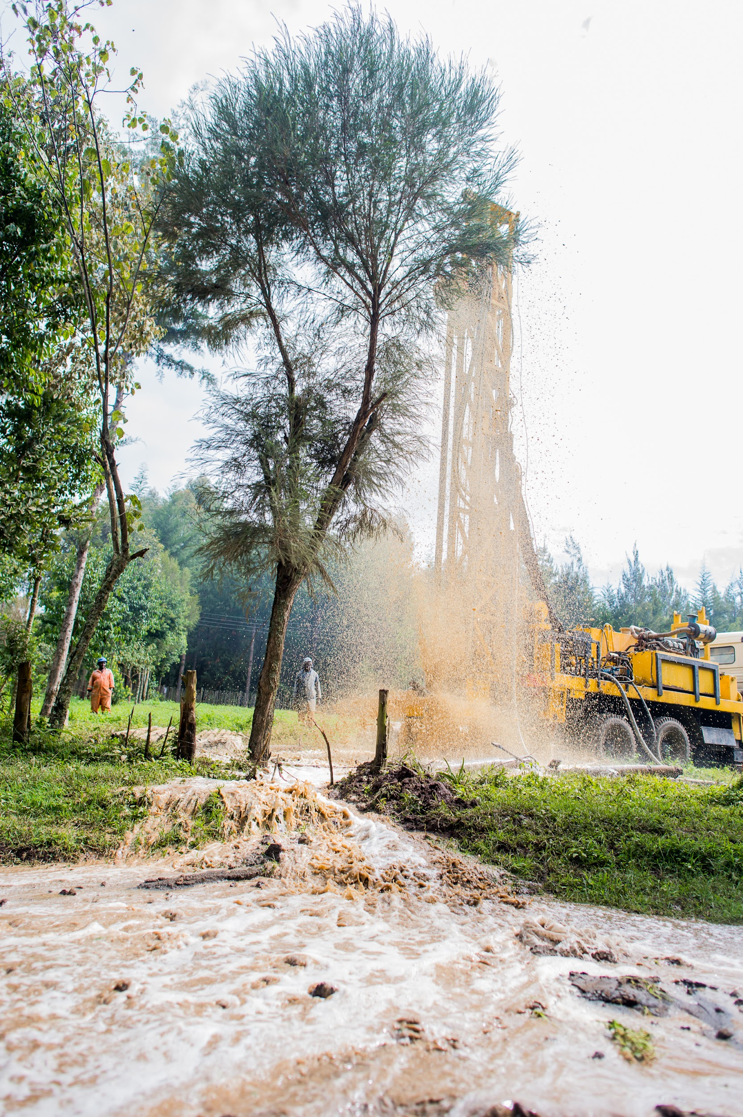
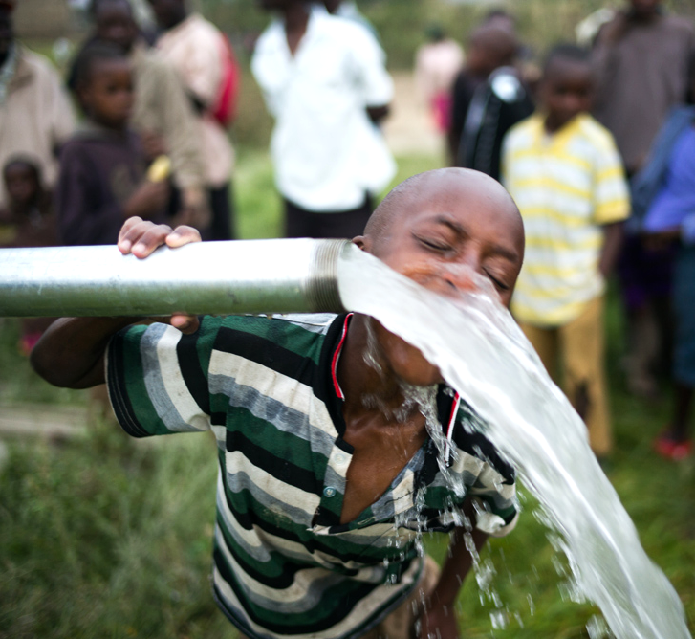
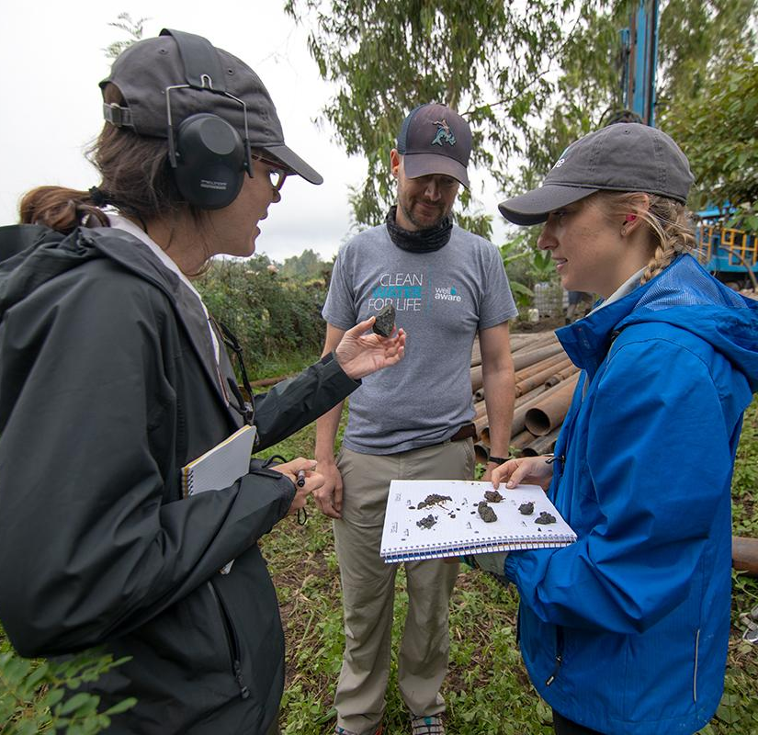
OUR IMPACT
14 YEARS
125+ PROJECTS
350,000+ LIVES

Slide 6
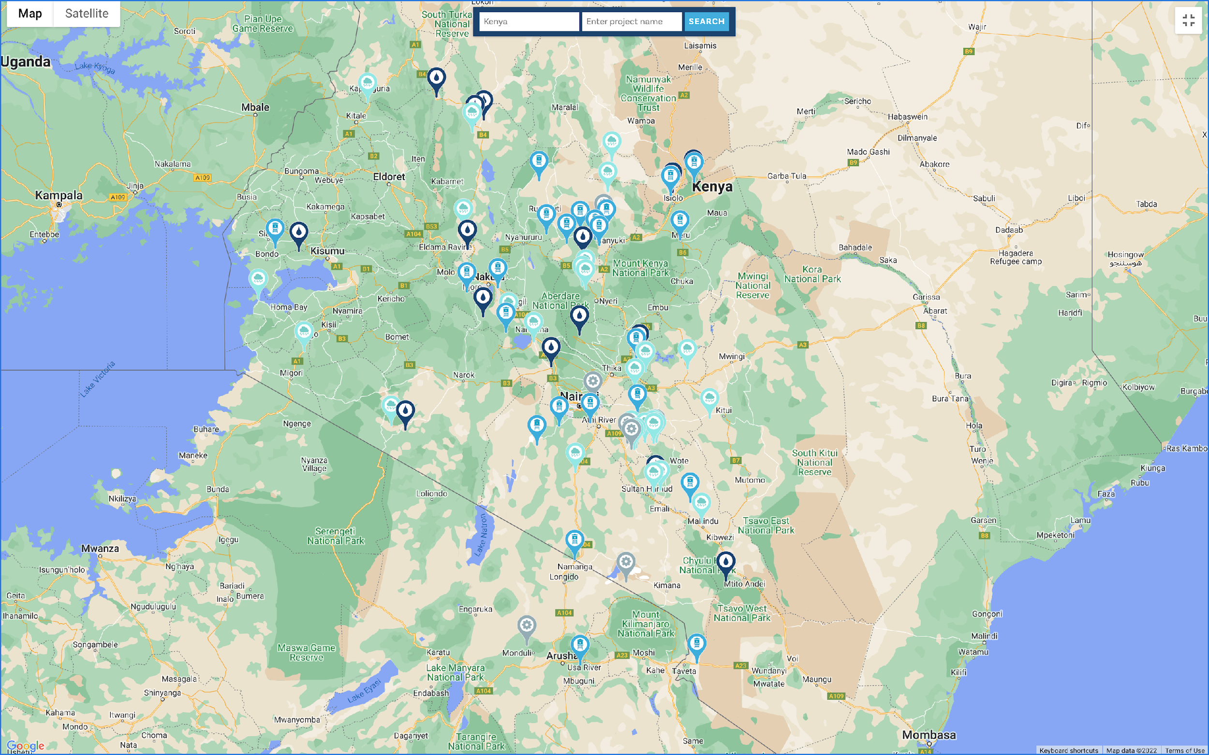
Geographic Coverage
Notes:
wellawareworld.org/water-project-news

Slide 7
THE HIDDEN GLOBAL WATER CRISIS
60% of water projects in Africa fail.

Slide 8
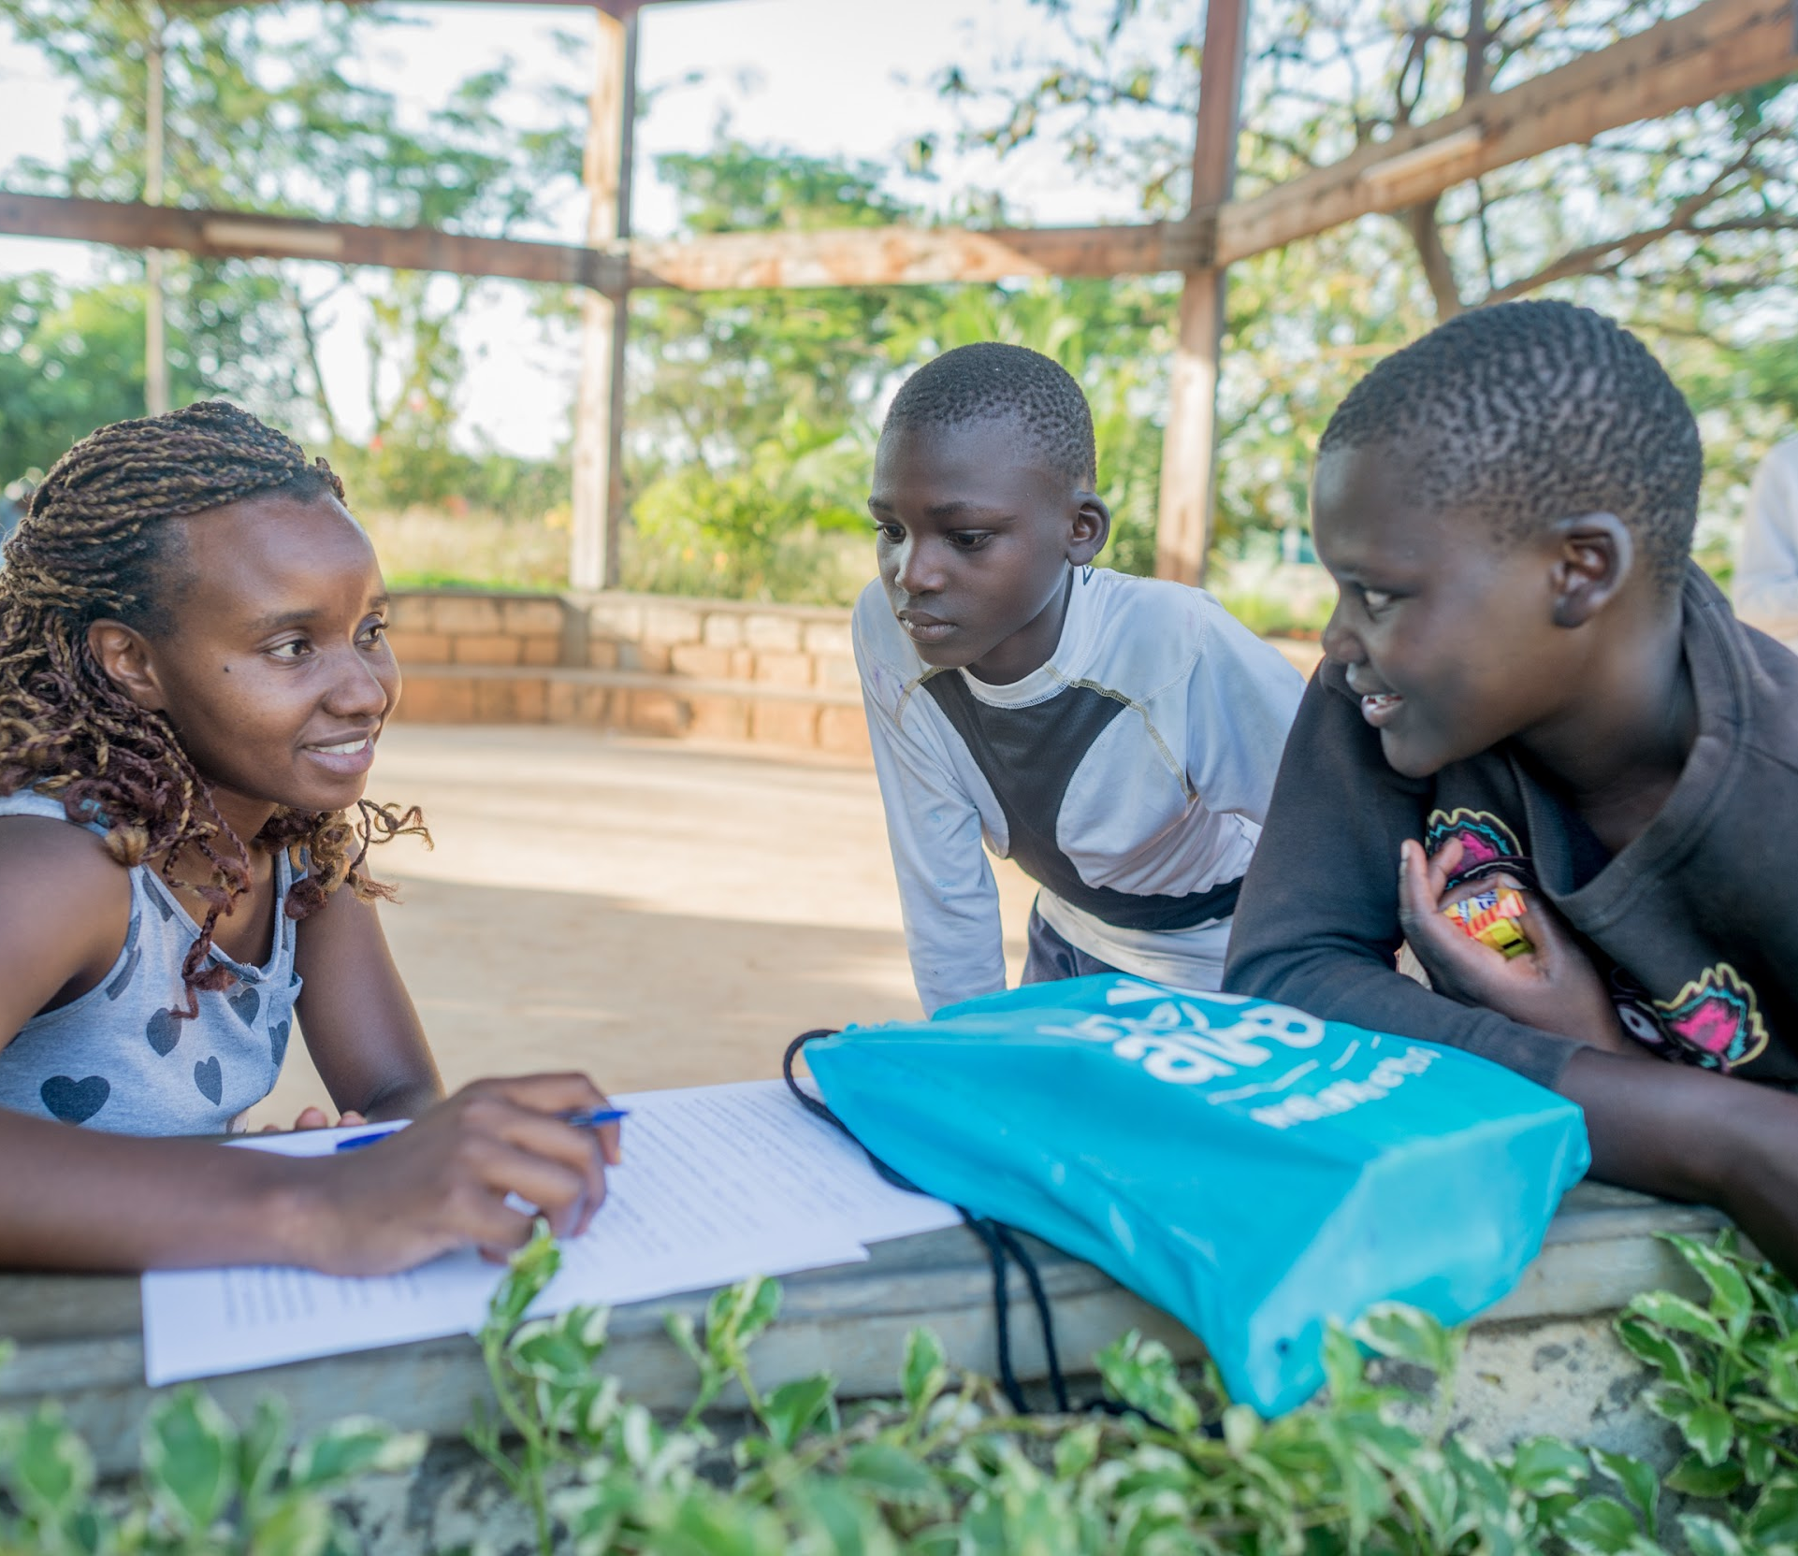
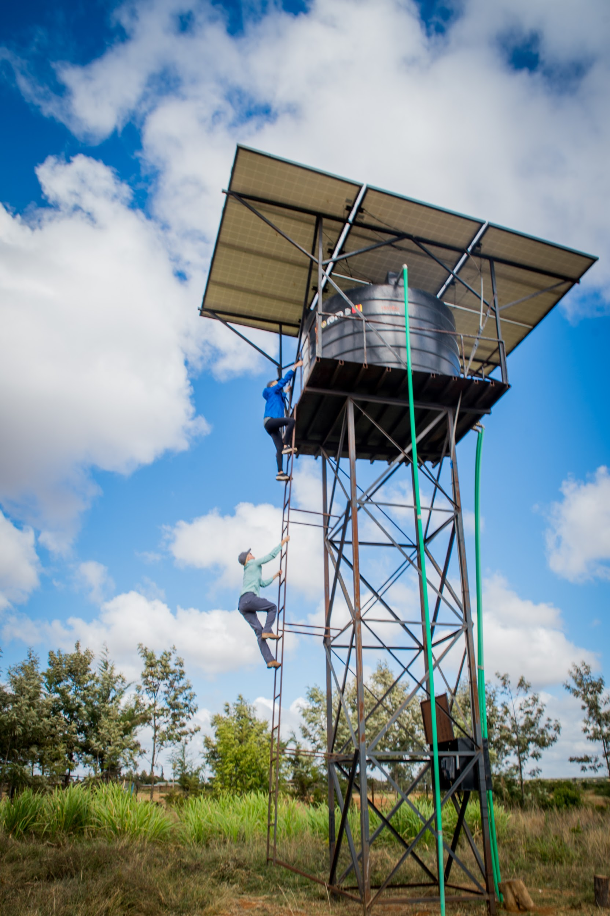
HOW WE’RE DIFFERENT: 100% Success Rate
Team of
Technical Experts
Community-Driven
Approach
Ongoing Maintenance

Slide 9
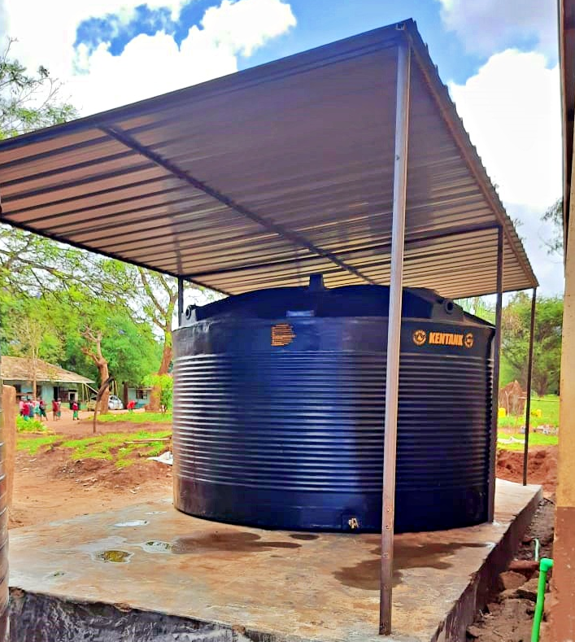
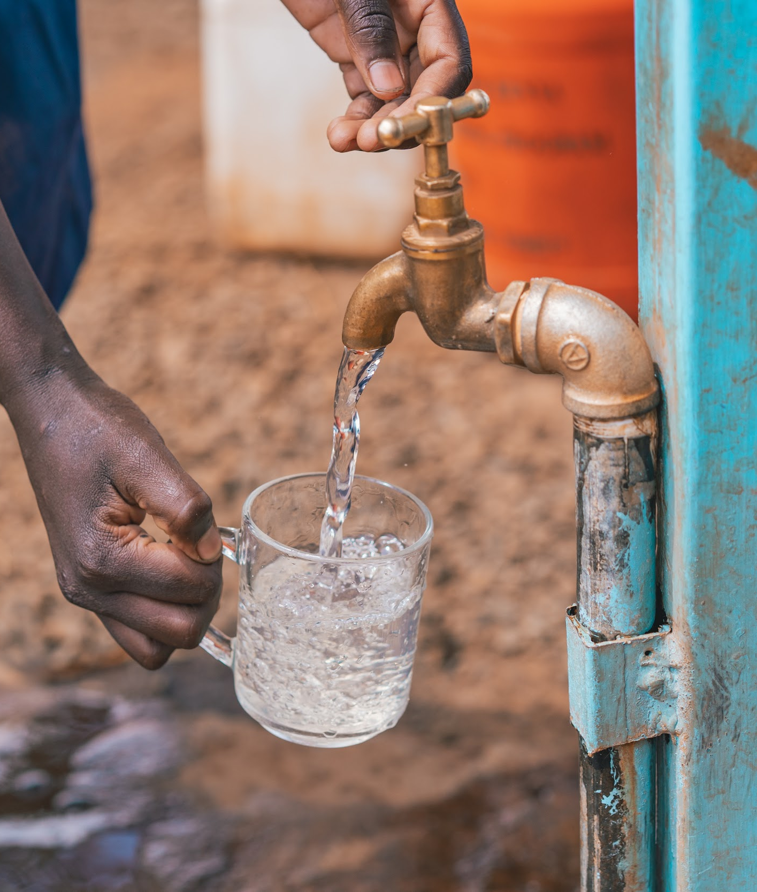
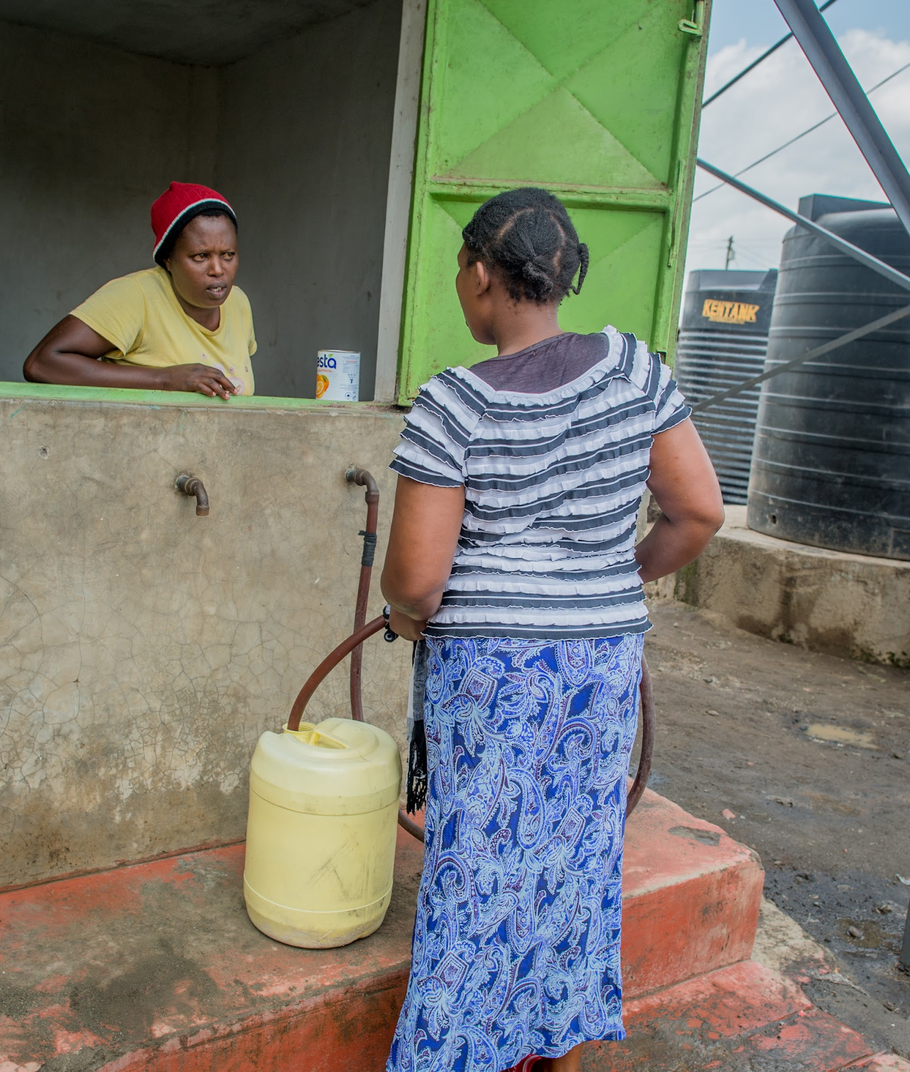
OUR PROJECTS
NEW DEEP BOREHOLE WELLS
RAINWATER SYSTEMS
REHABS & MORE
Notes:
Kareece

Slide 10
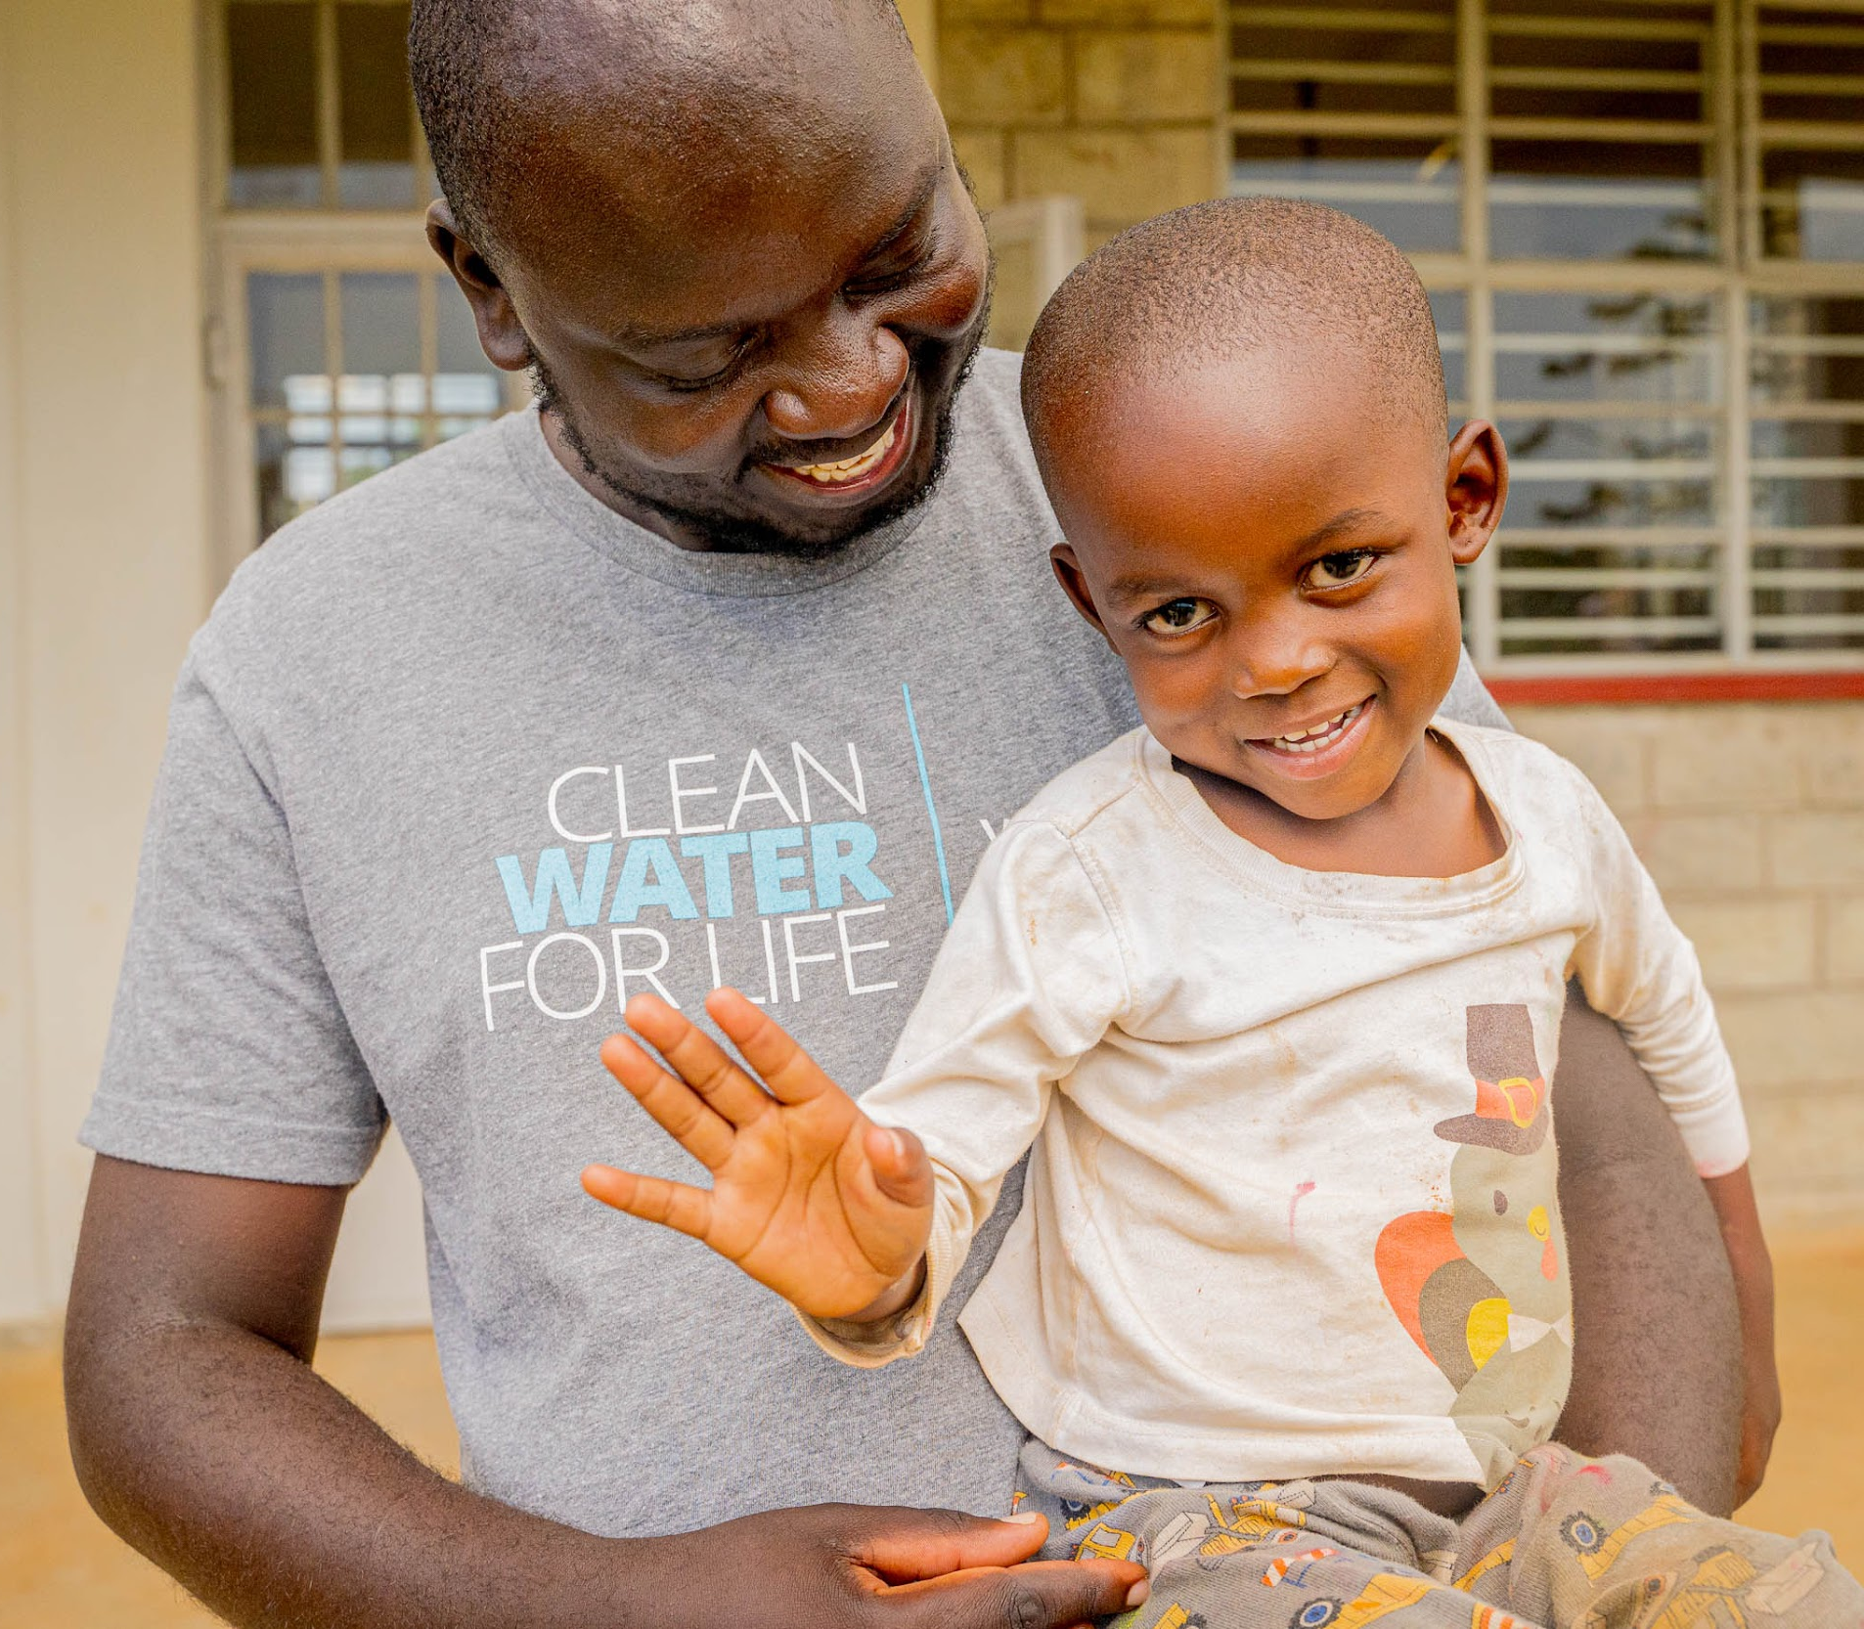
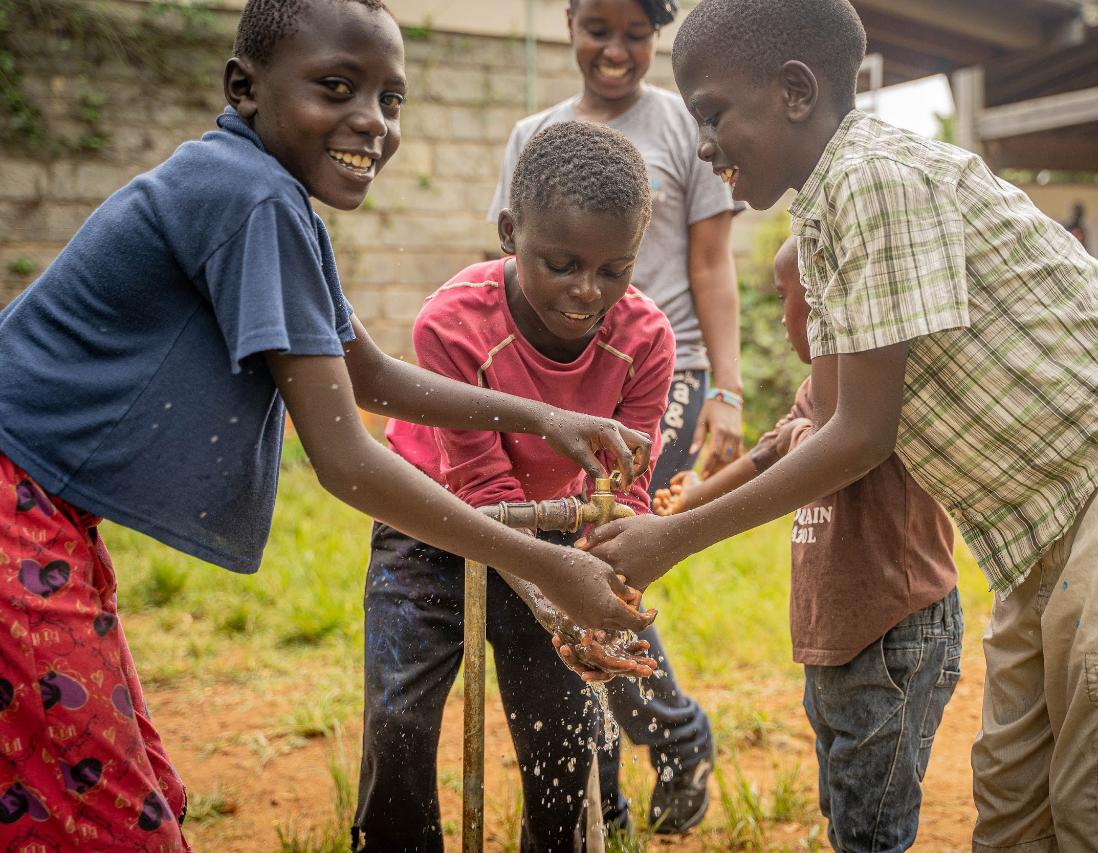
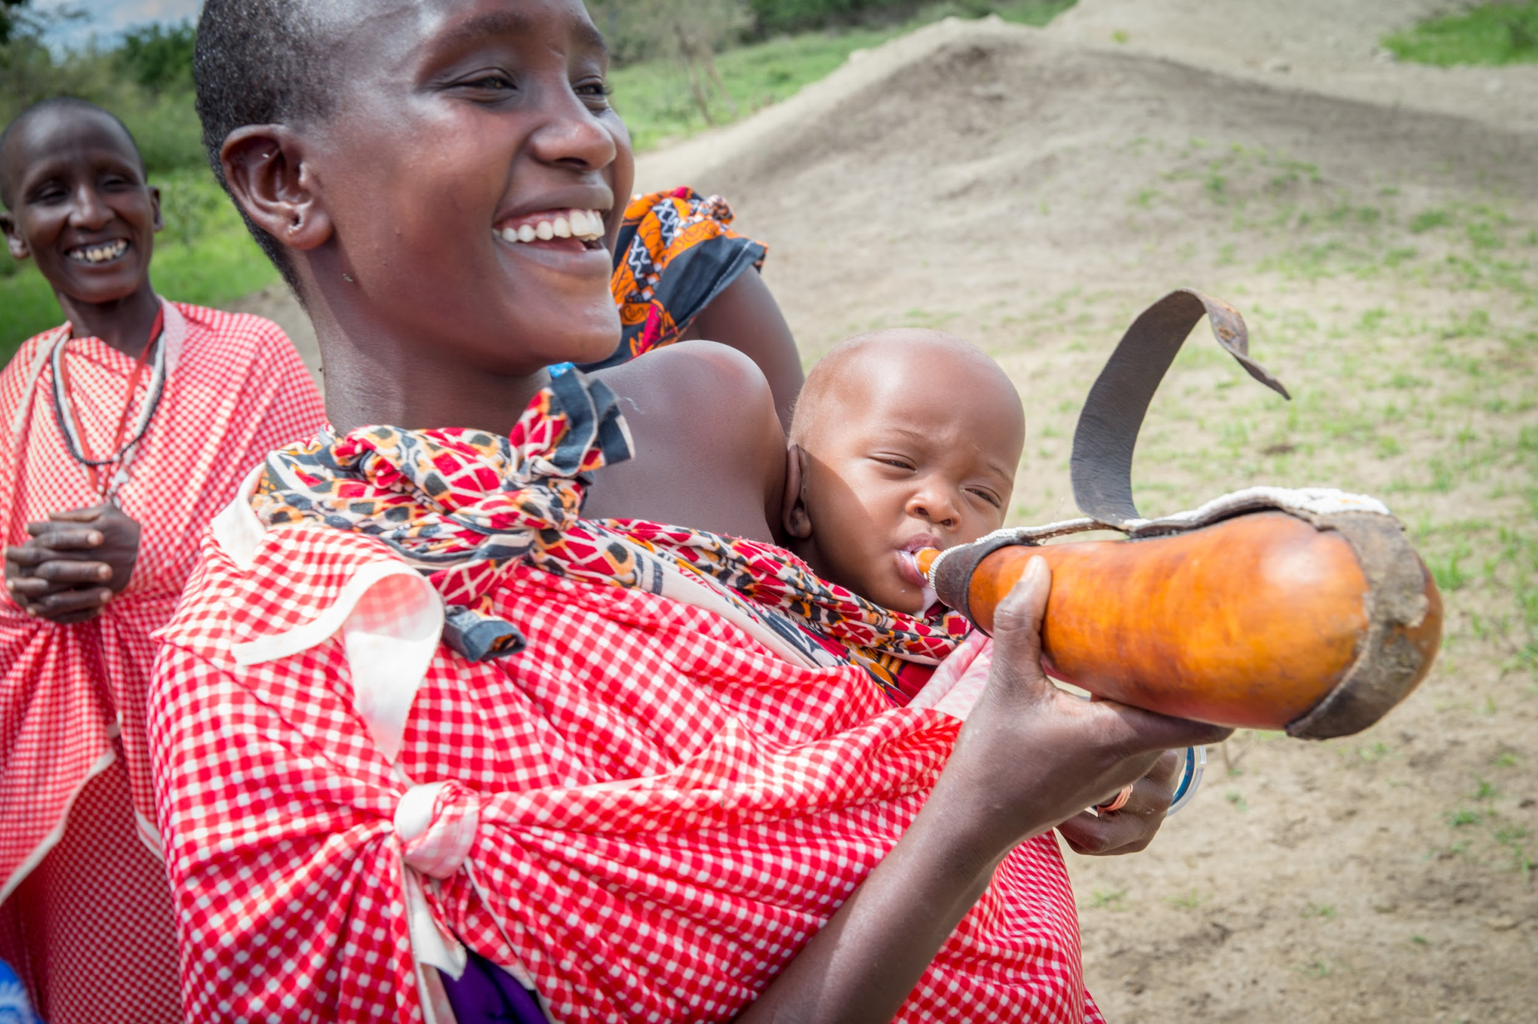
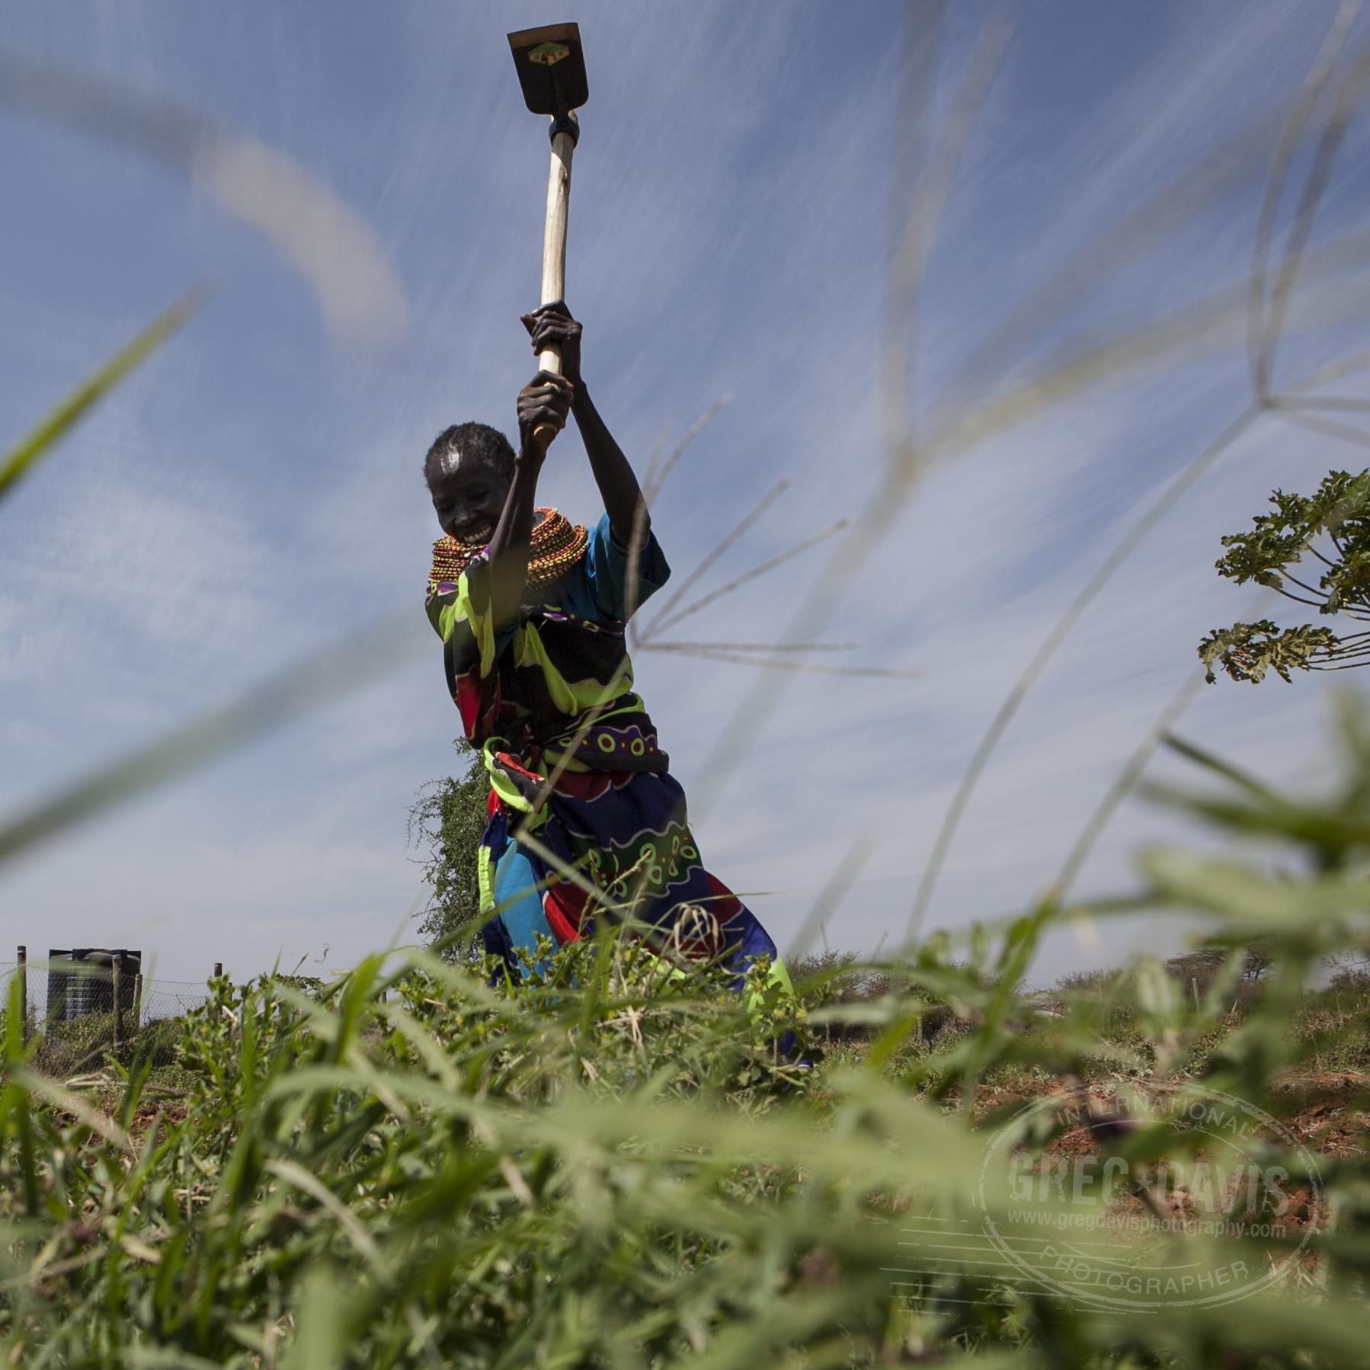
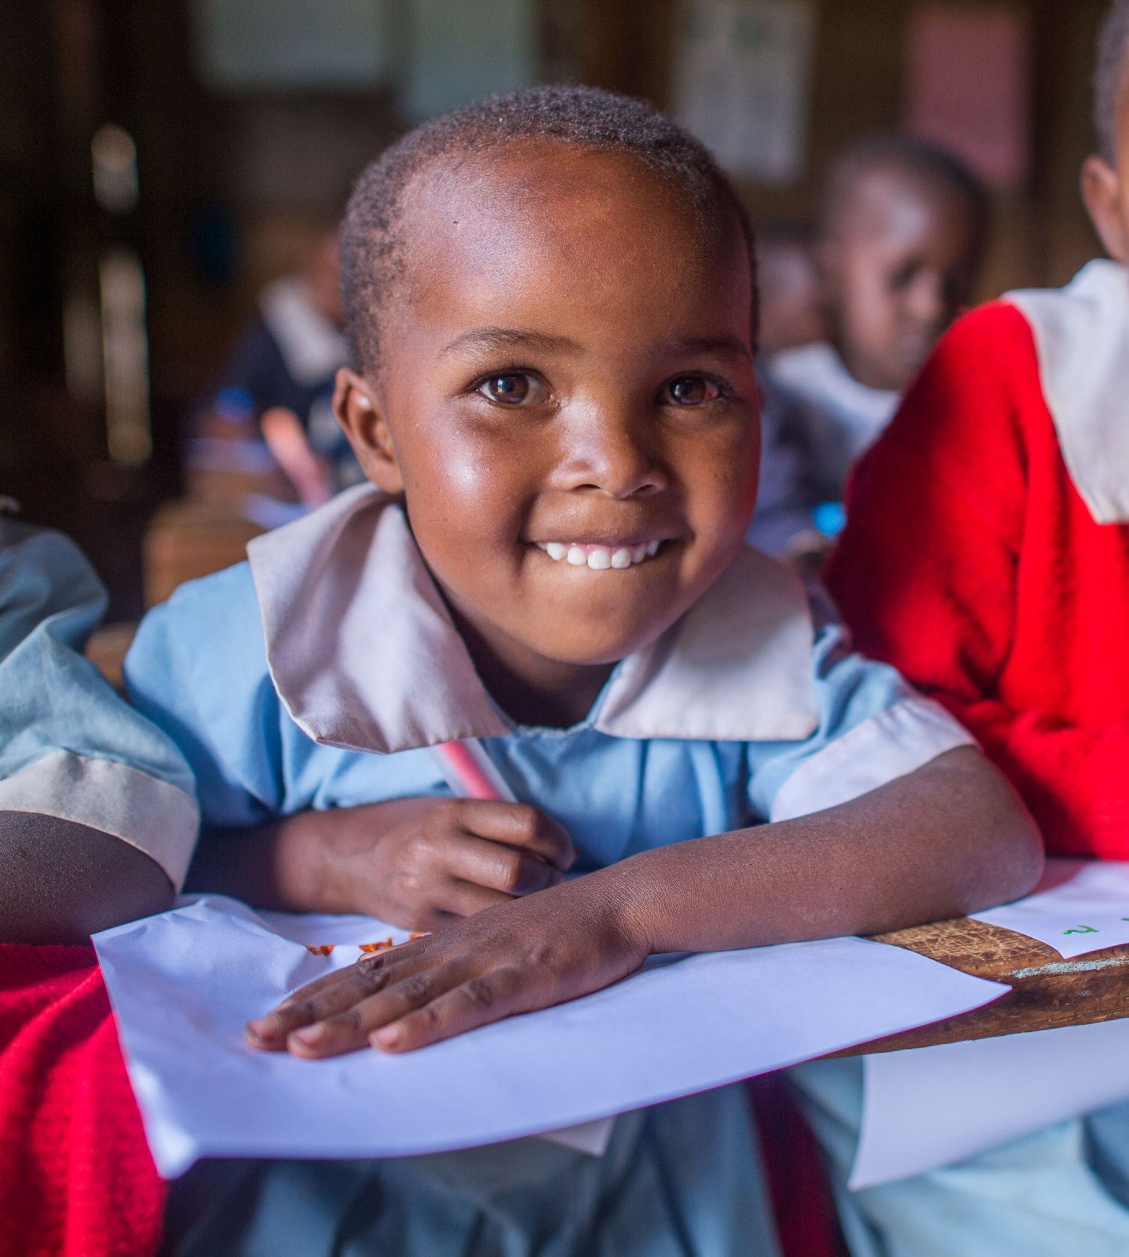
OUR RIPPLE EFFECT

Slide 11
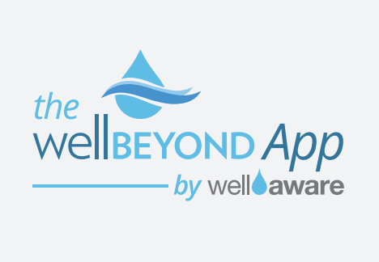
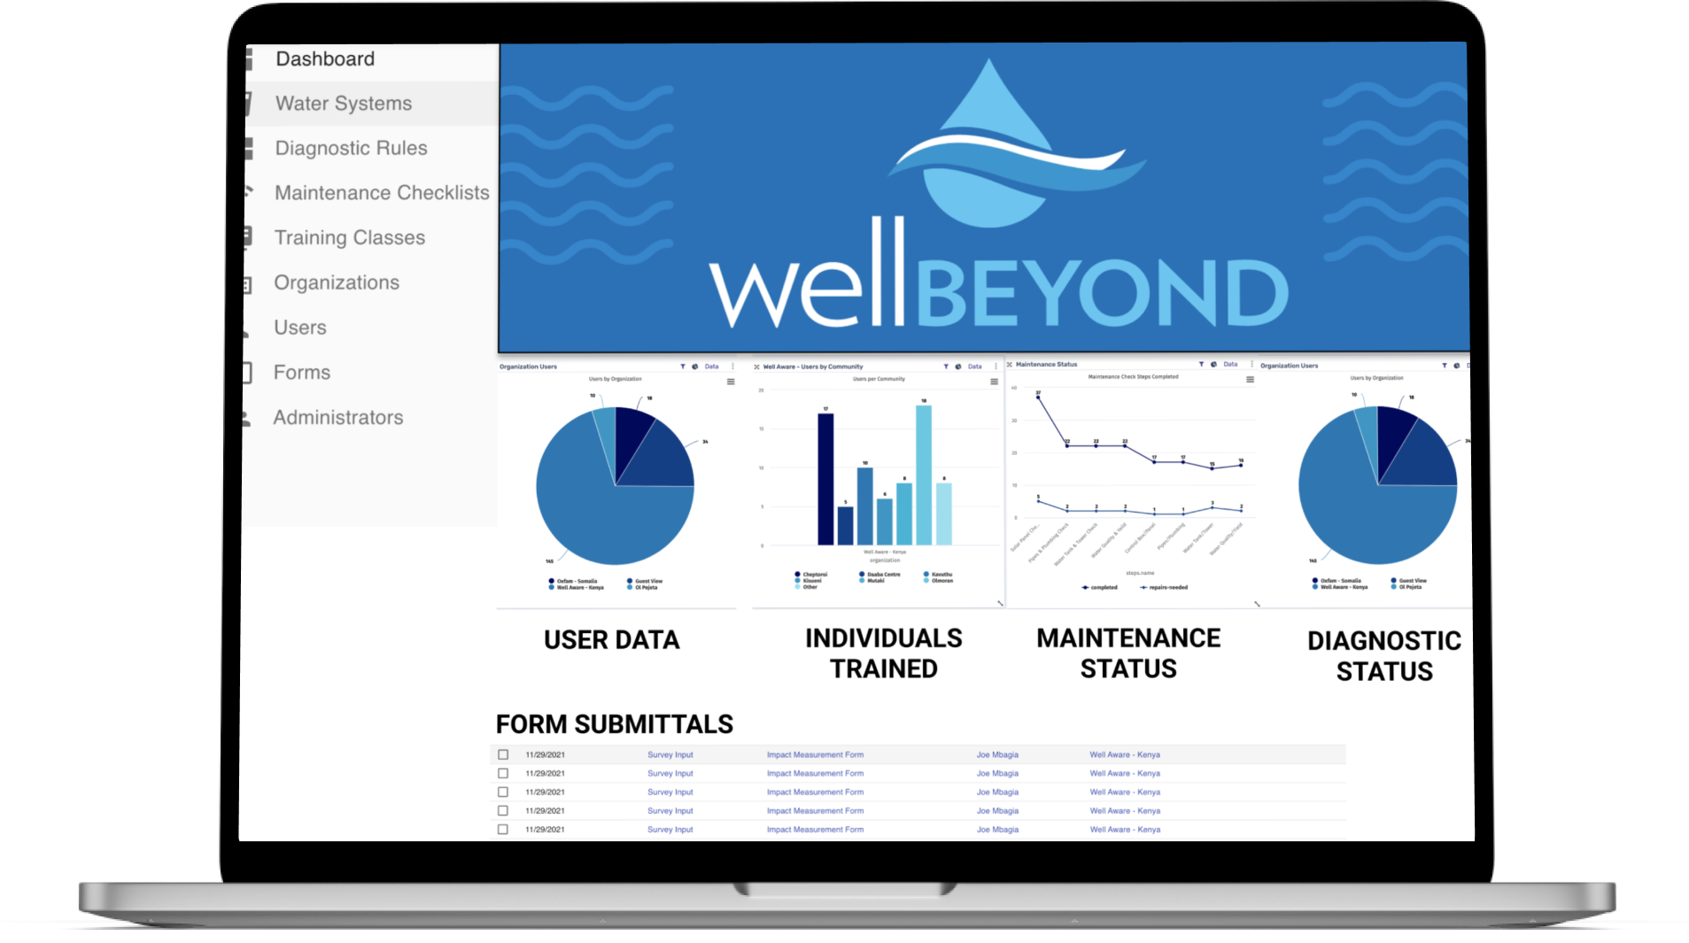
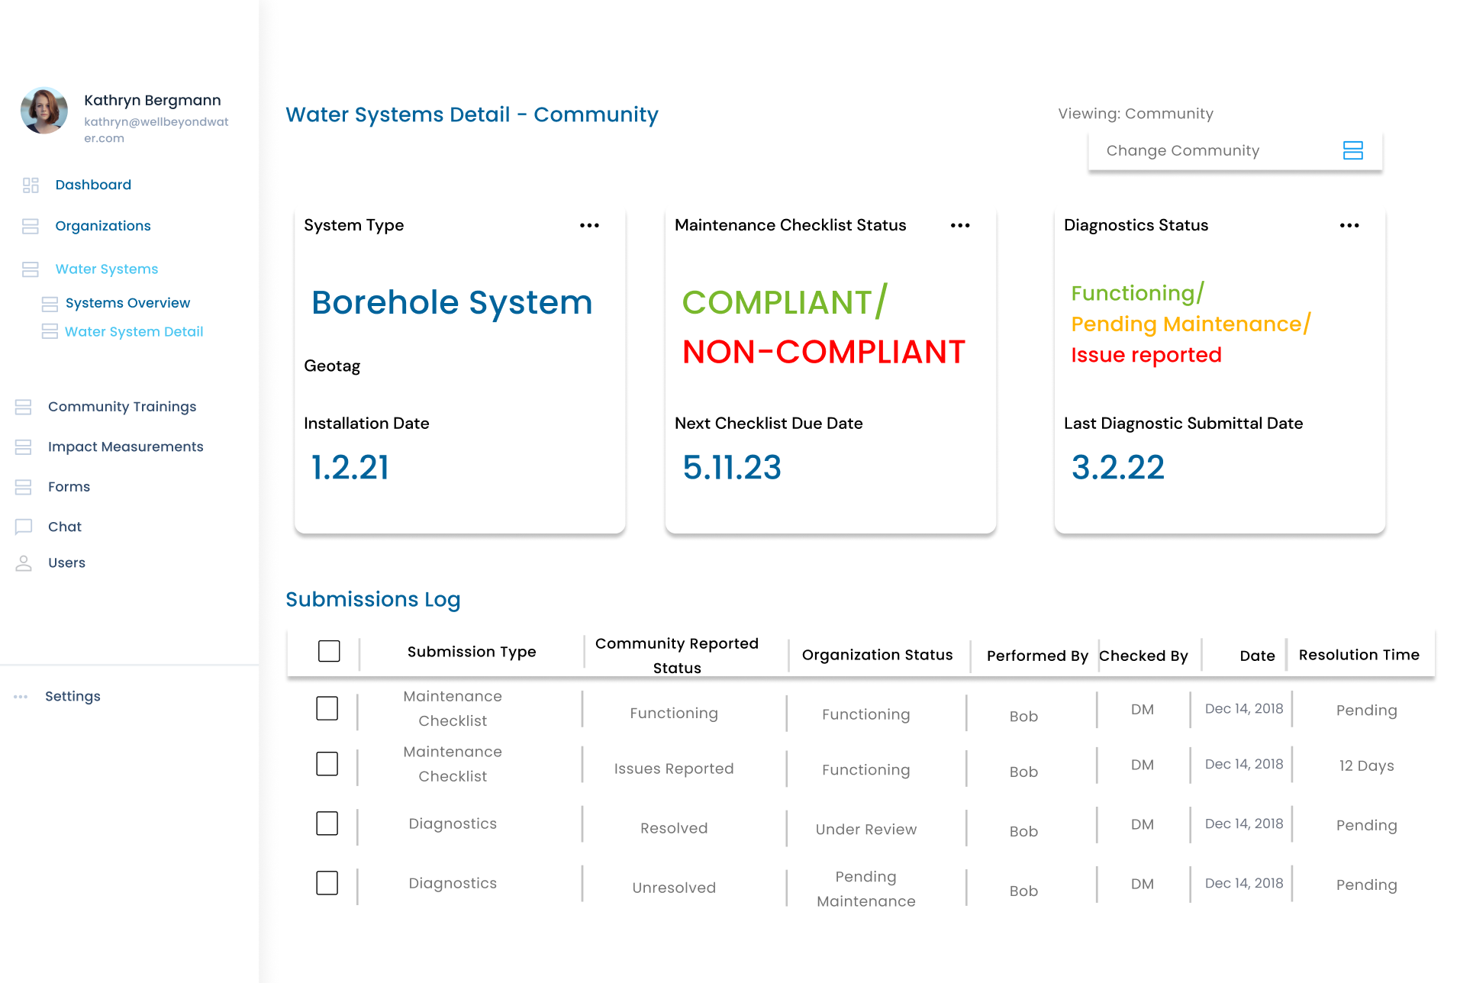
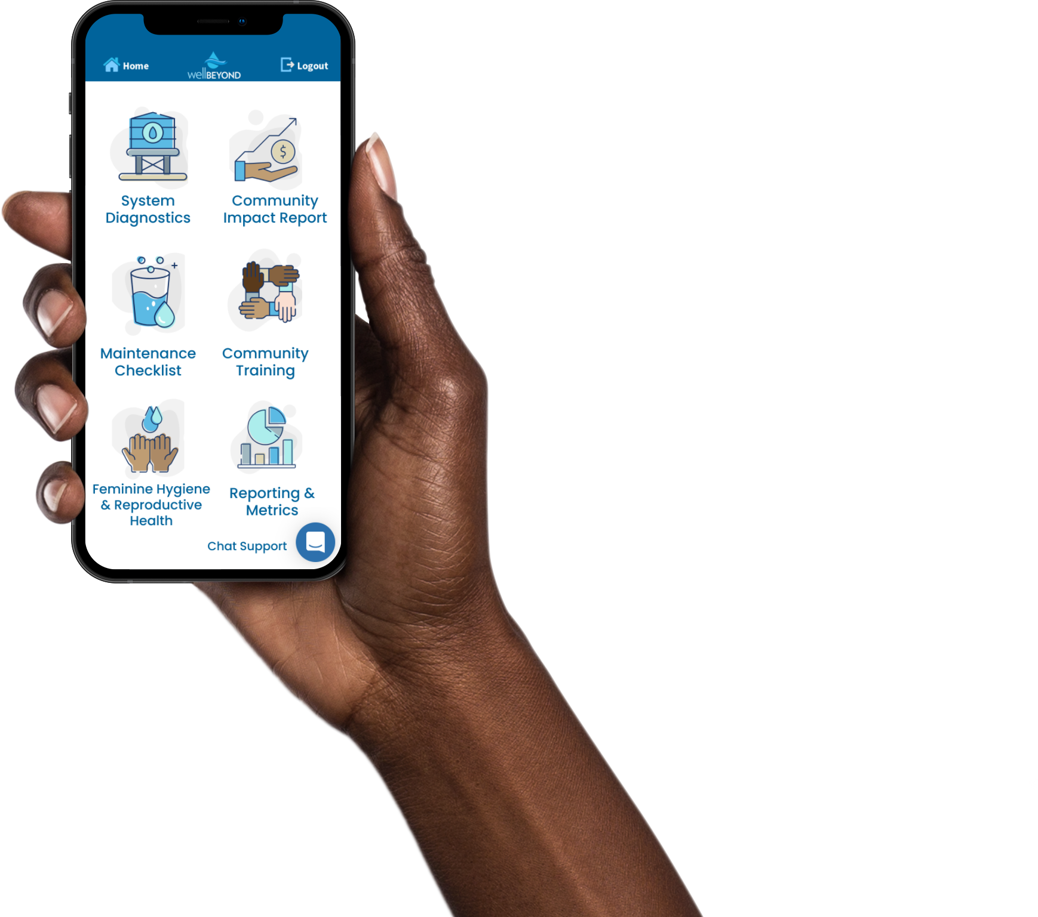
The industry’s first and only mobile app for ensuring lasting water projects
Notes:
https://wellawareworld.org/well-beyond-app/

Slide 12
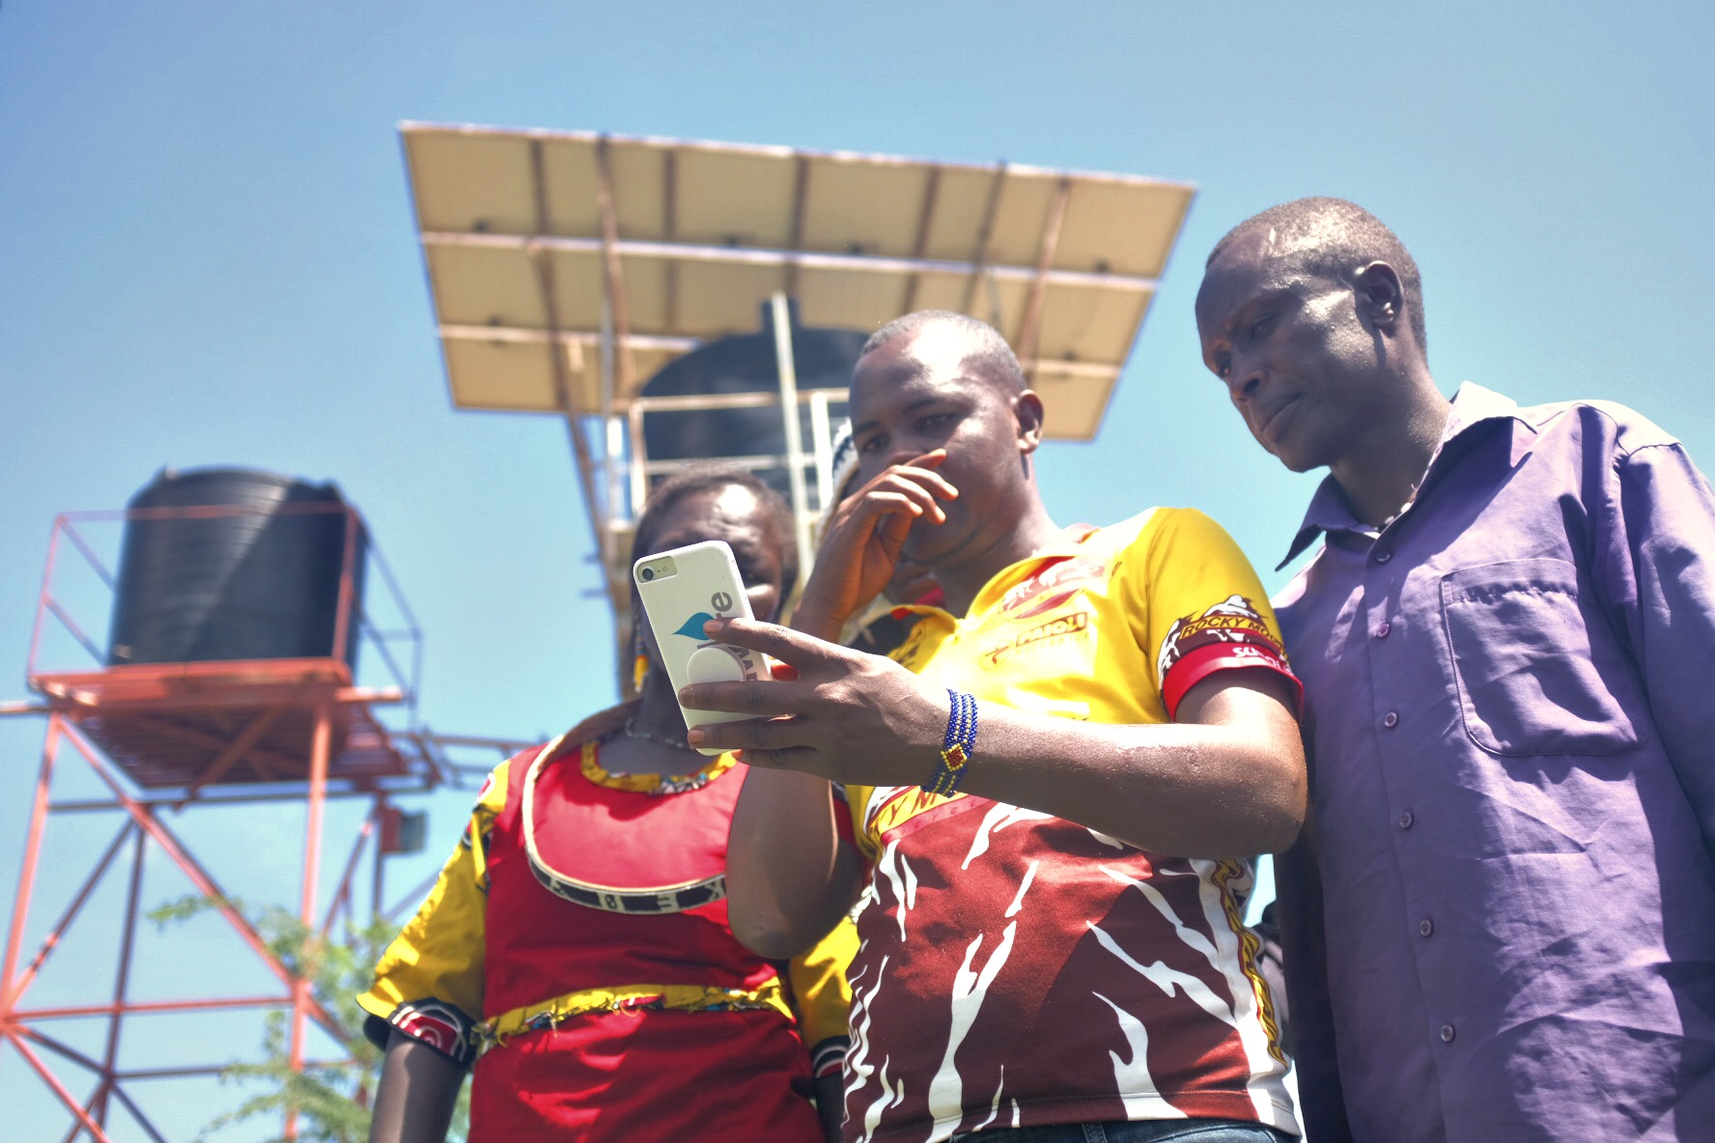
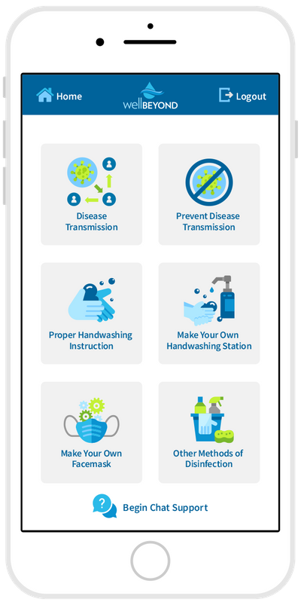
THE WELL BEYOND APP
Helping our partner communities access the tools they need to diagnose issues and maintain their water systems
Notes:
https://wellawareworld.org/well-beyond-app/

Slide 13
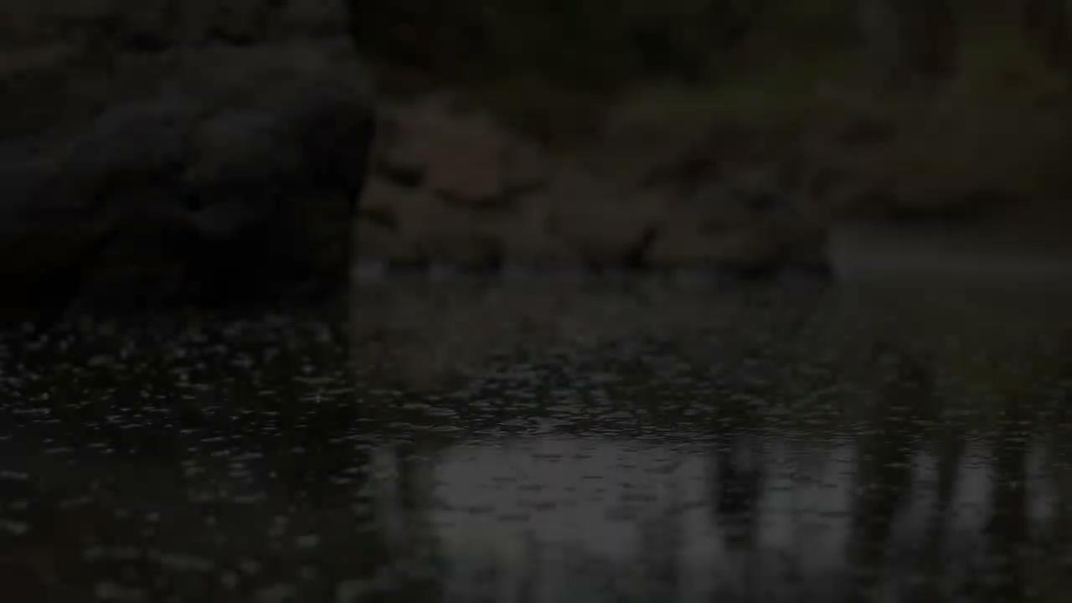

Slide 14
AWARDS & RECOGNITION
Notes:
https://wellawareworld.org/press

Slide 15
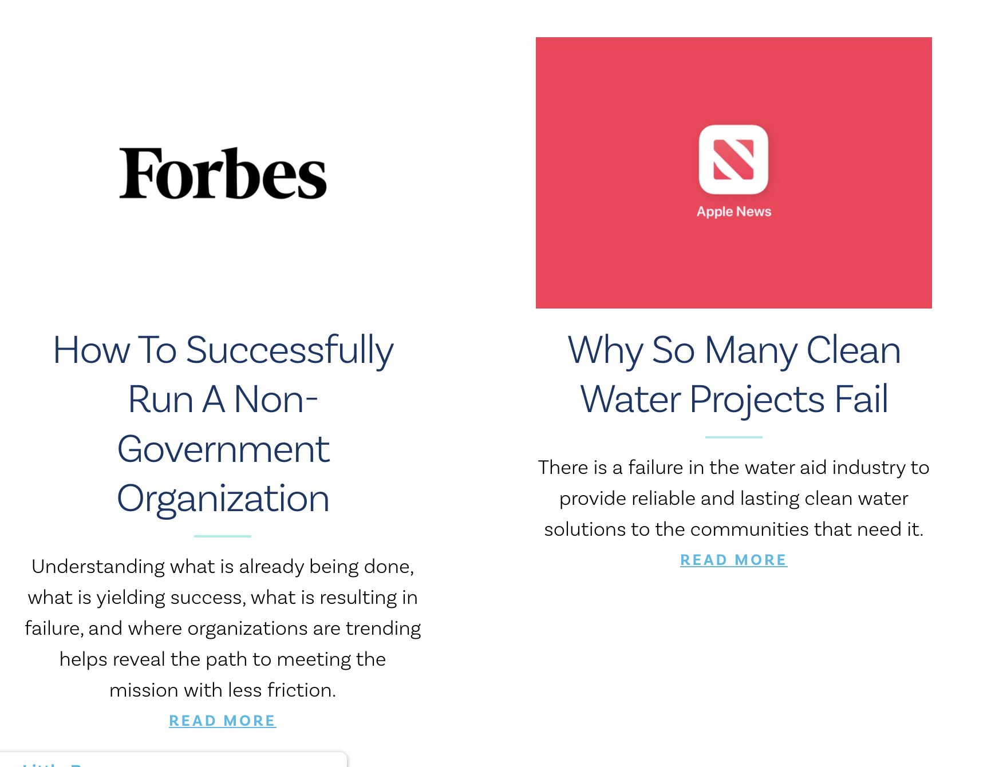
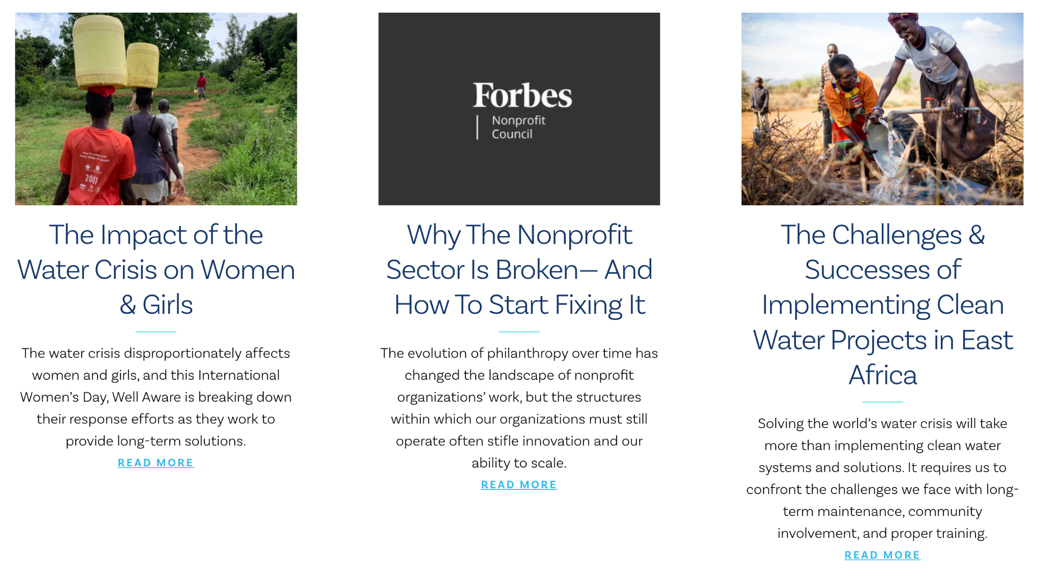
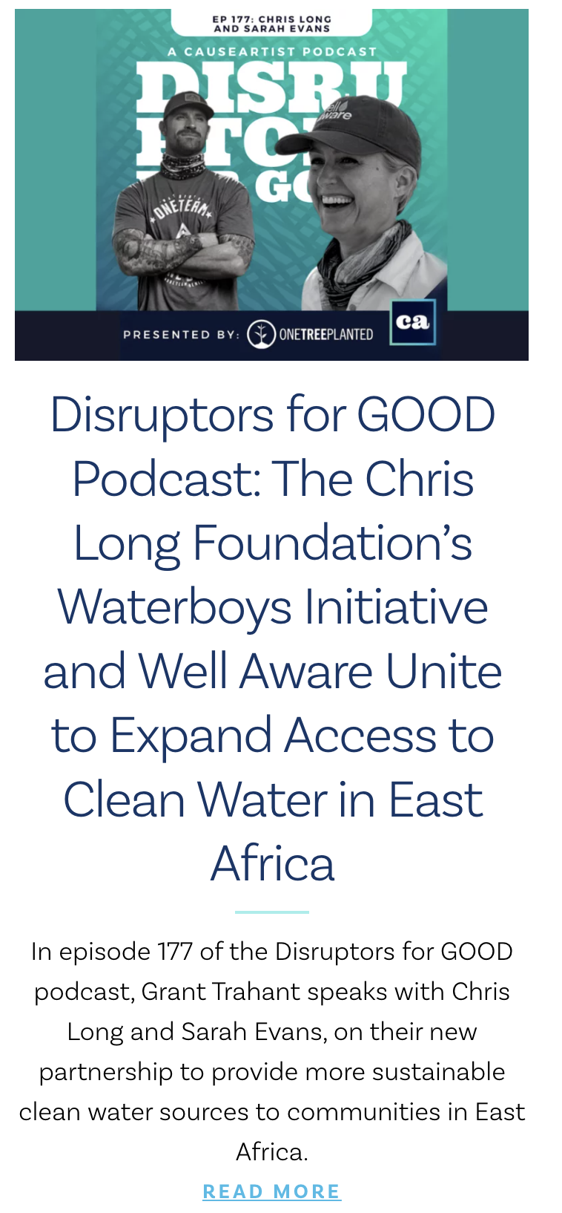
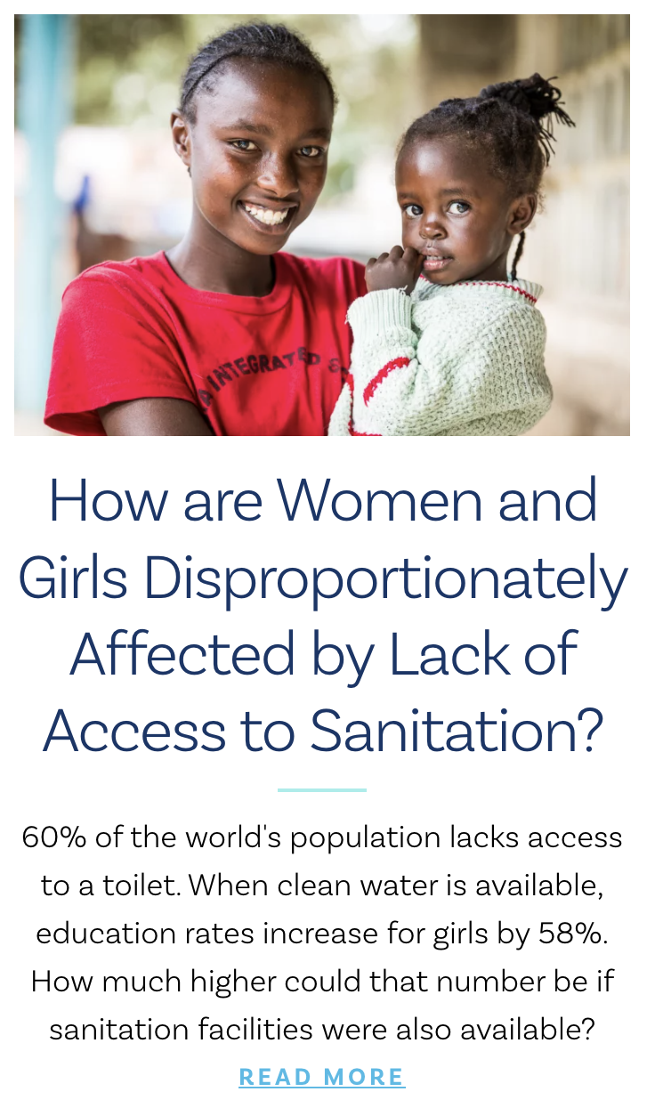
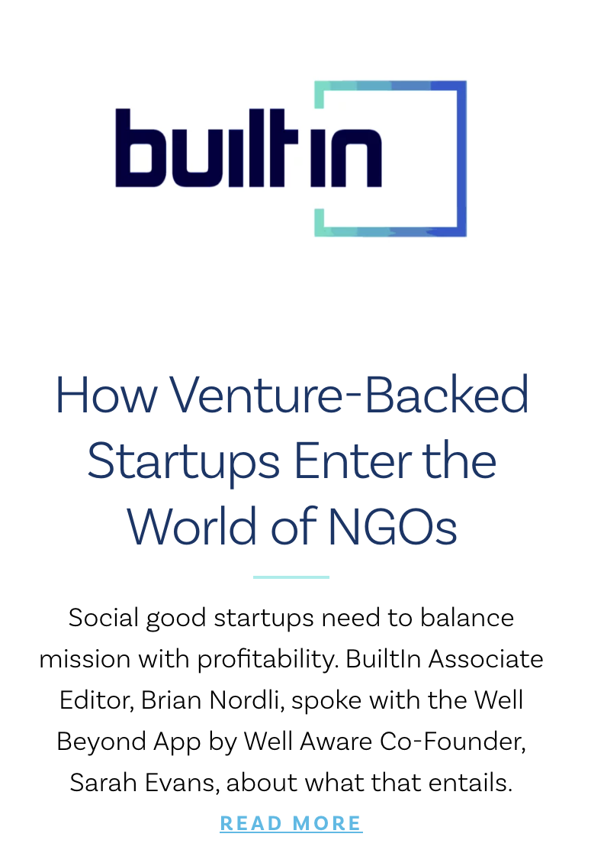
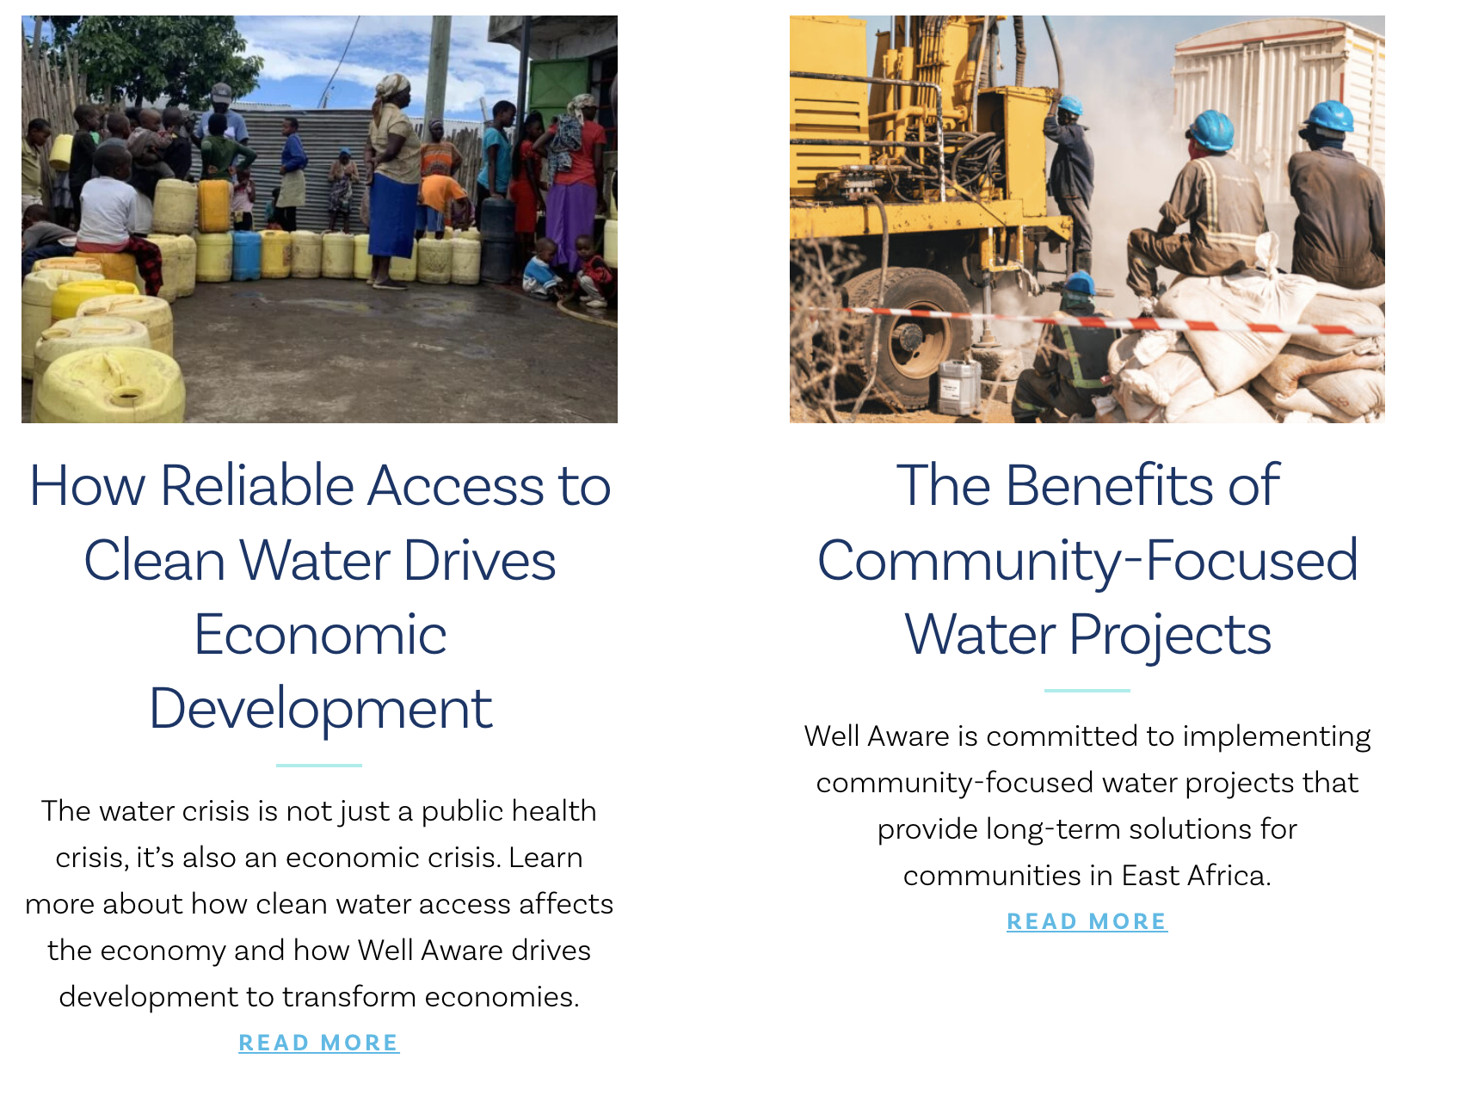
FEATURES & THOUGHT LEADERSHIP
Notes:
https://wellawareworld.org/press

Slide 16
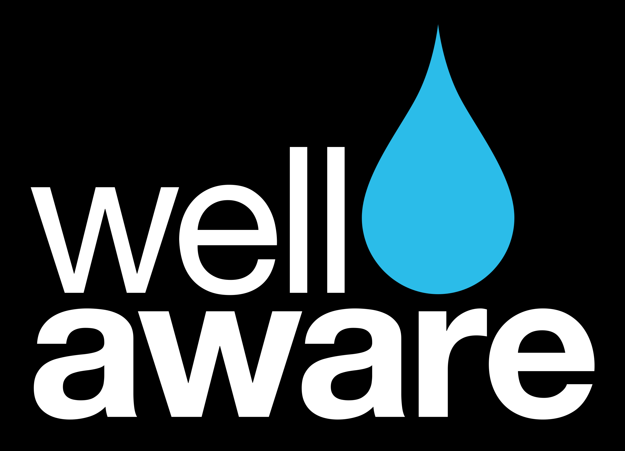
Project Highlights
Notes:
wellawareworld.org/water-project-news

Slide 17
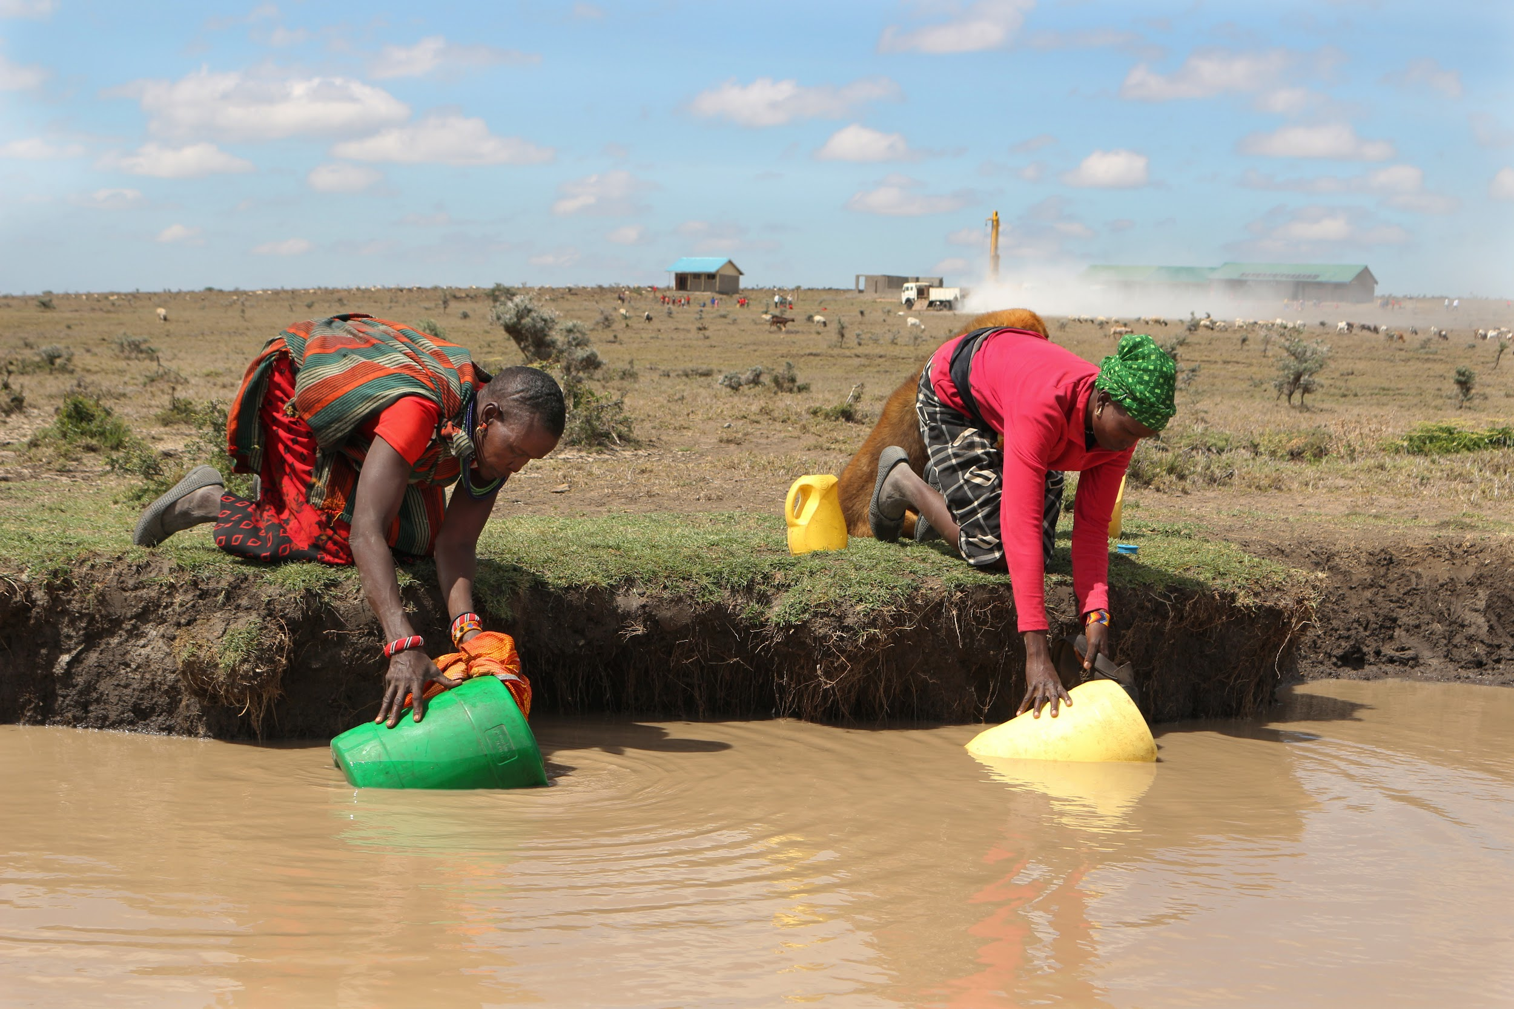
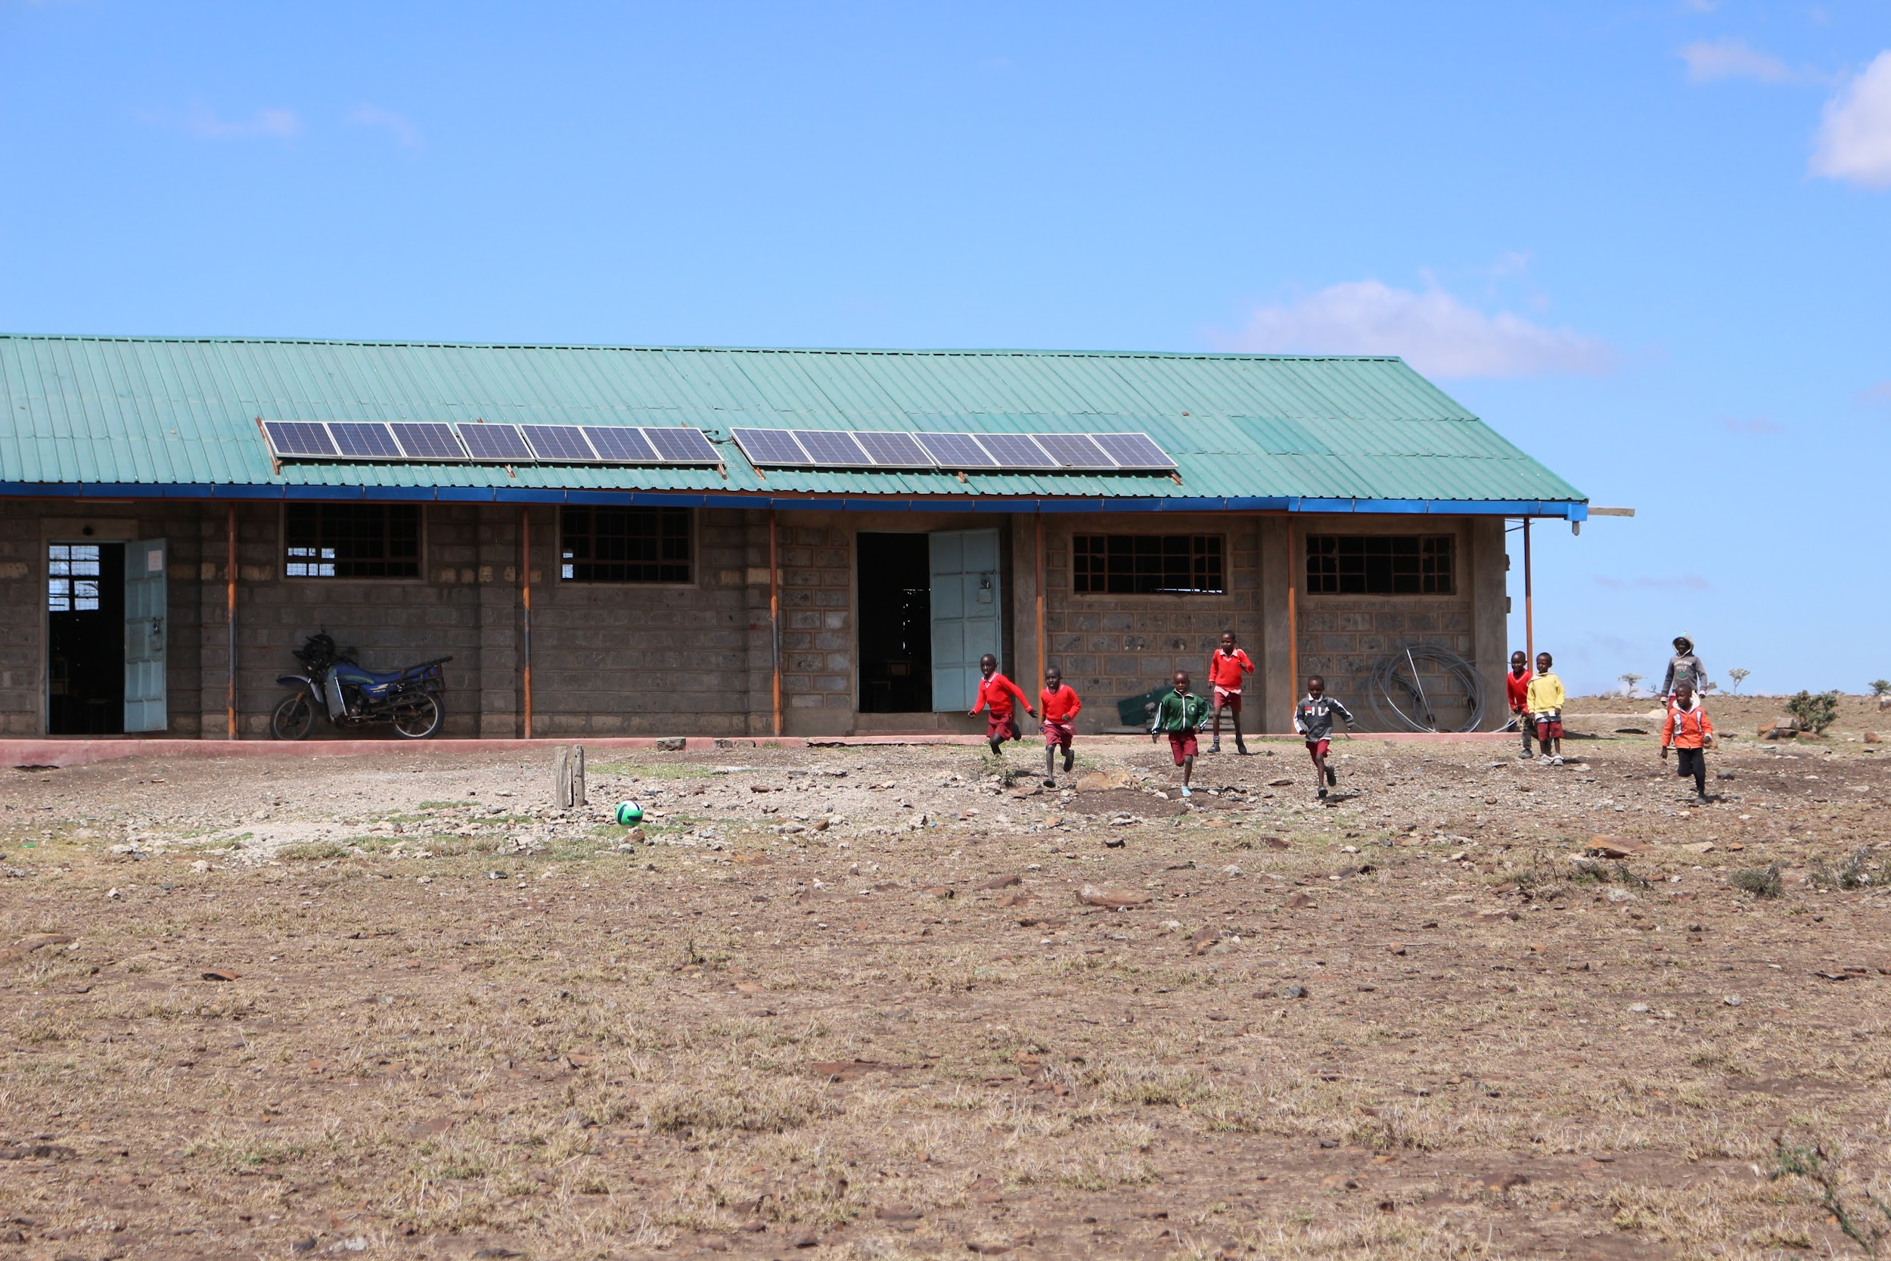
TANGI NYUESI, KENYA
Notes:
https://wellawareworld.org/tangi-nyeusi/

Slide 18
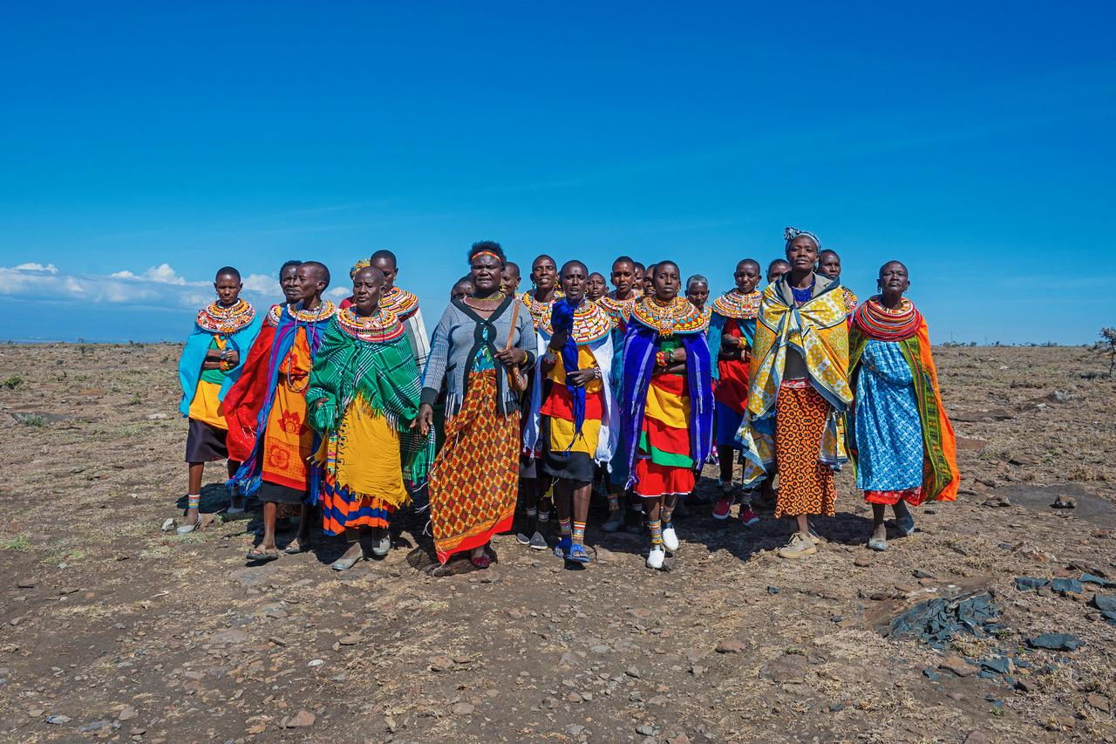
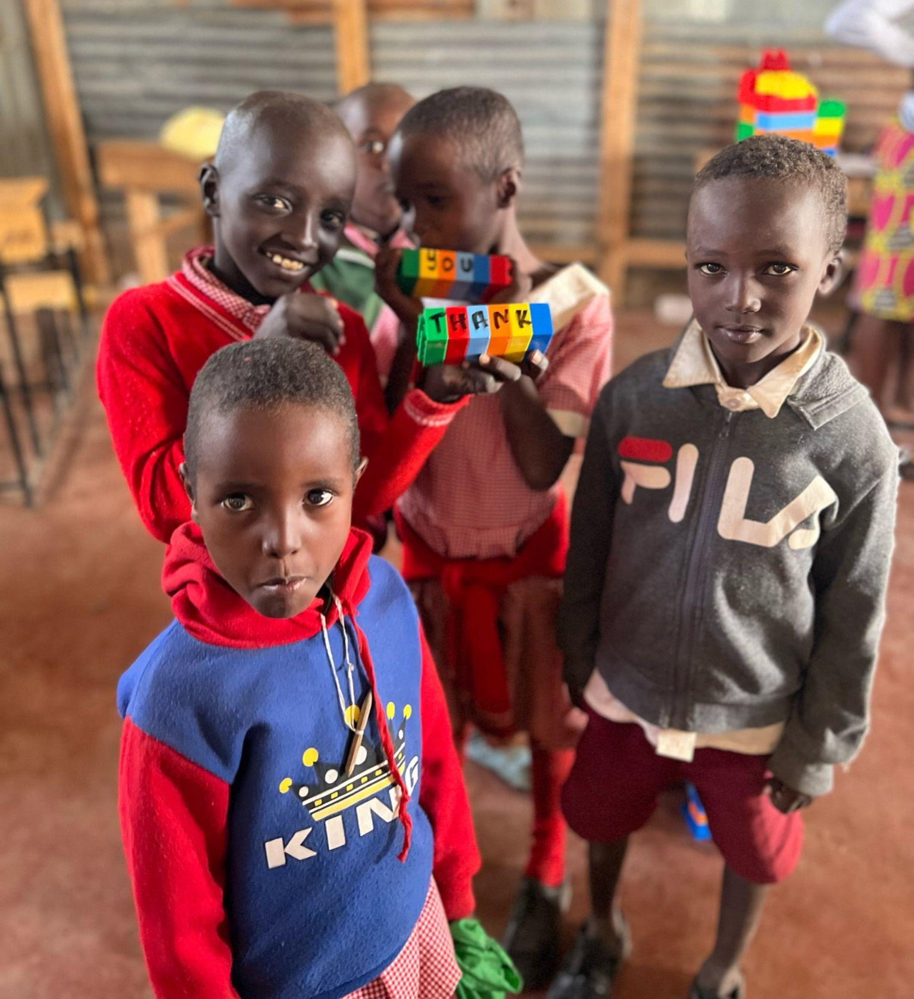
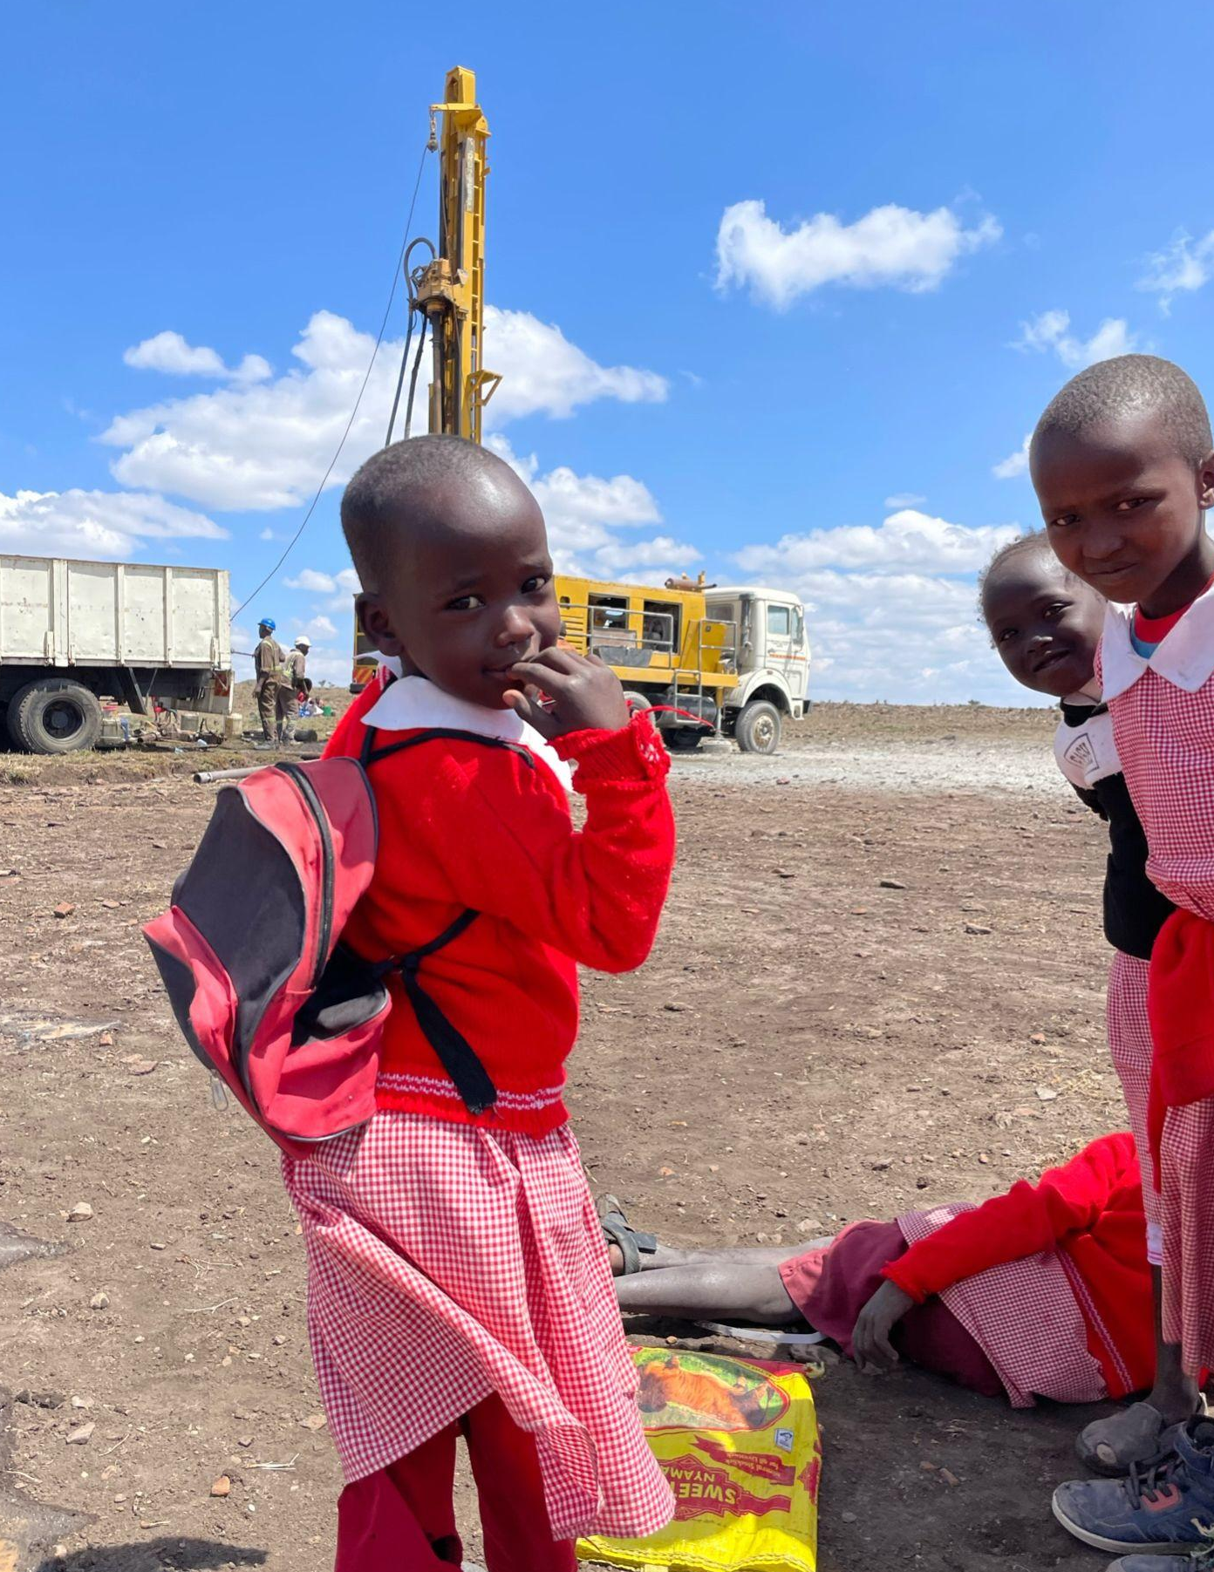
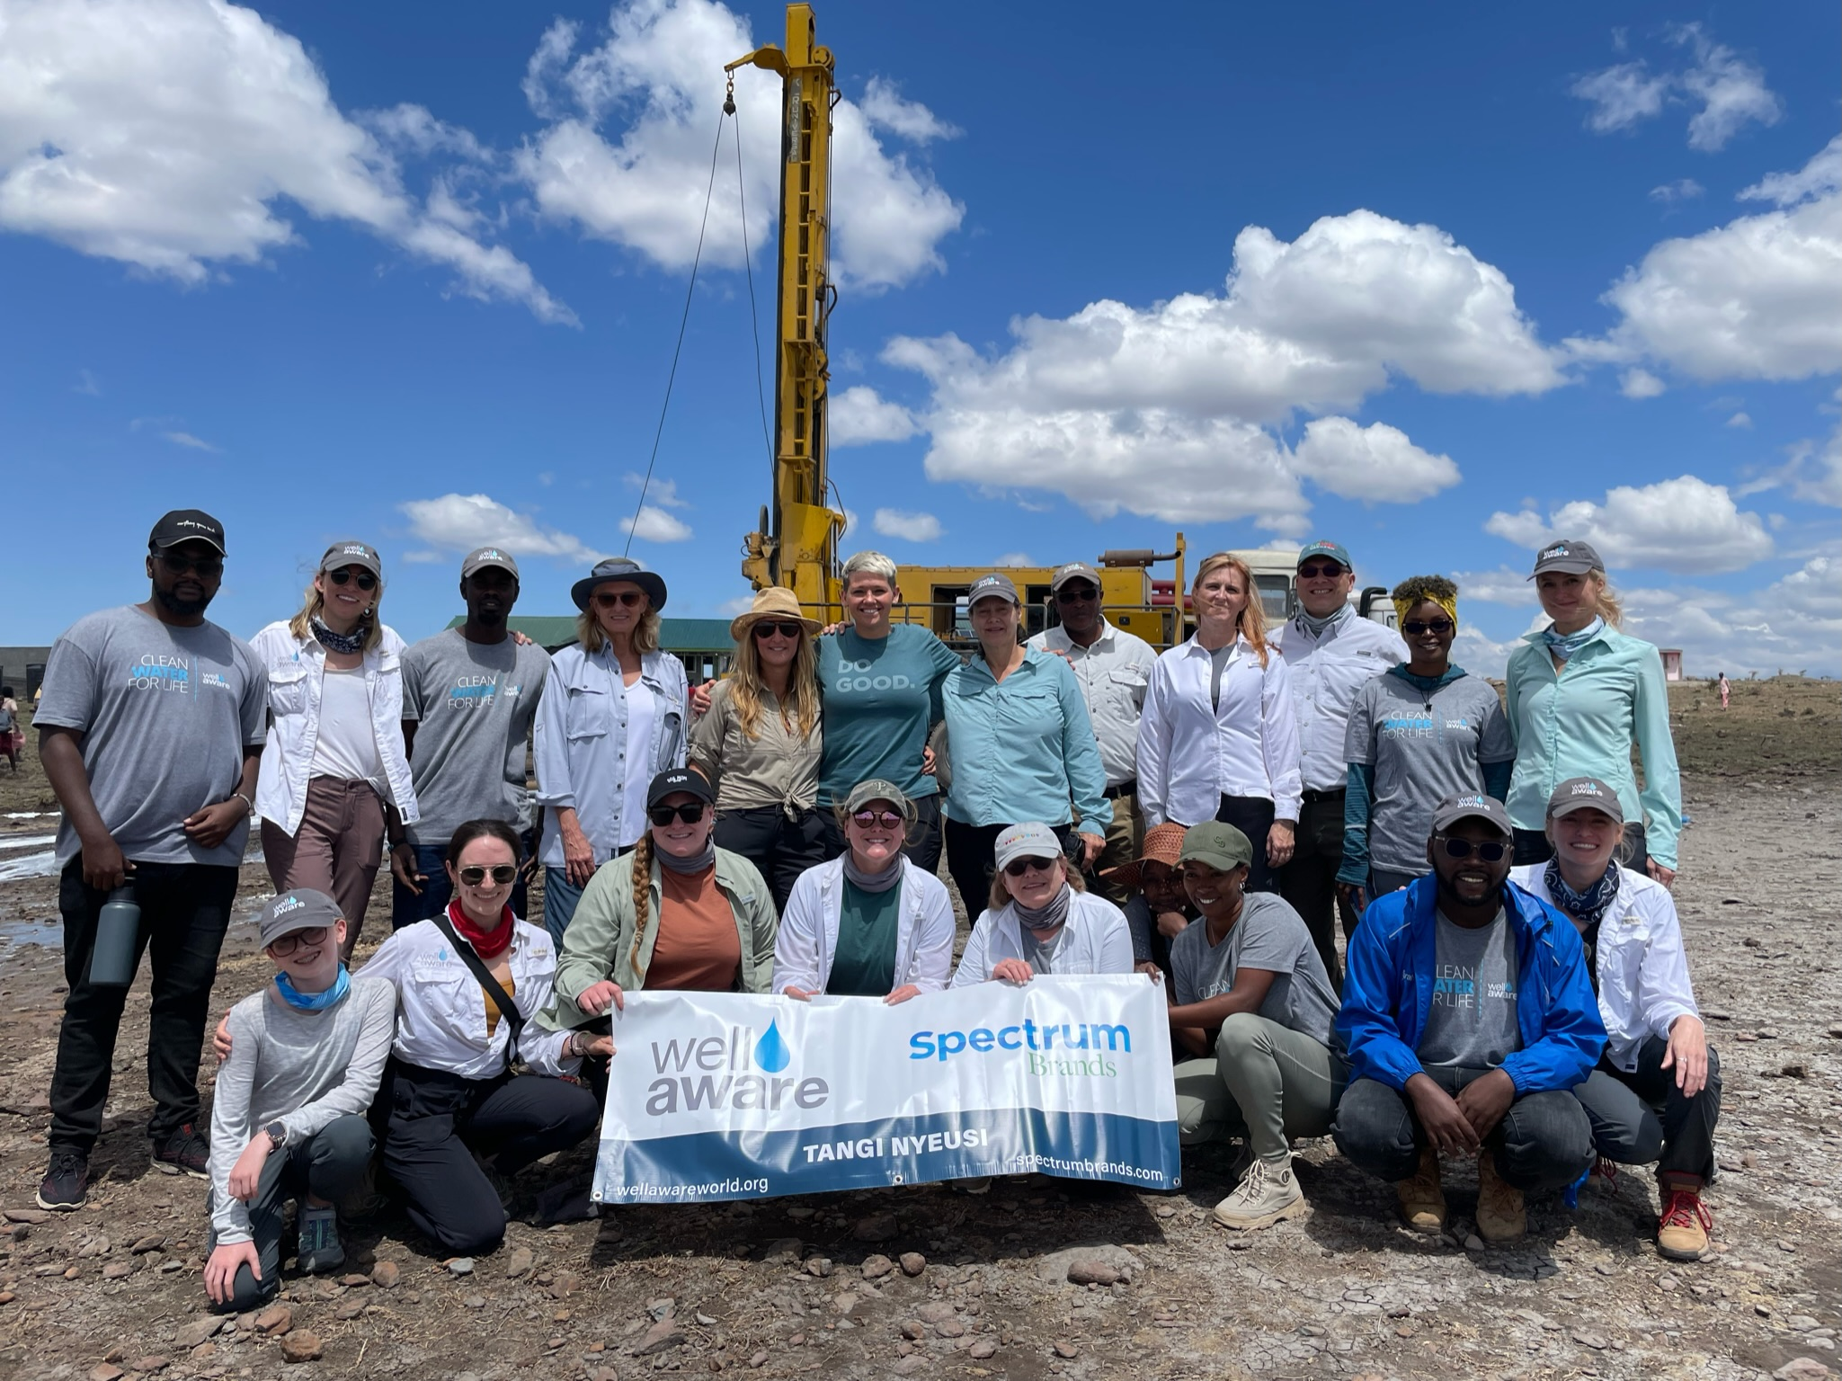
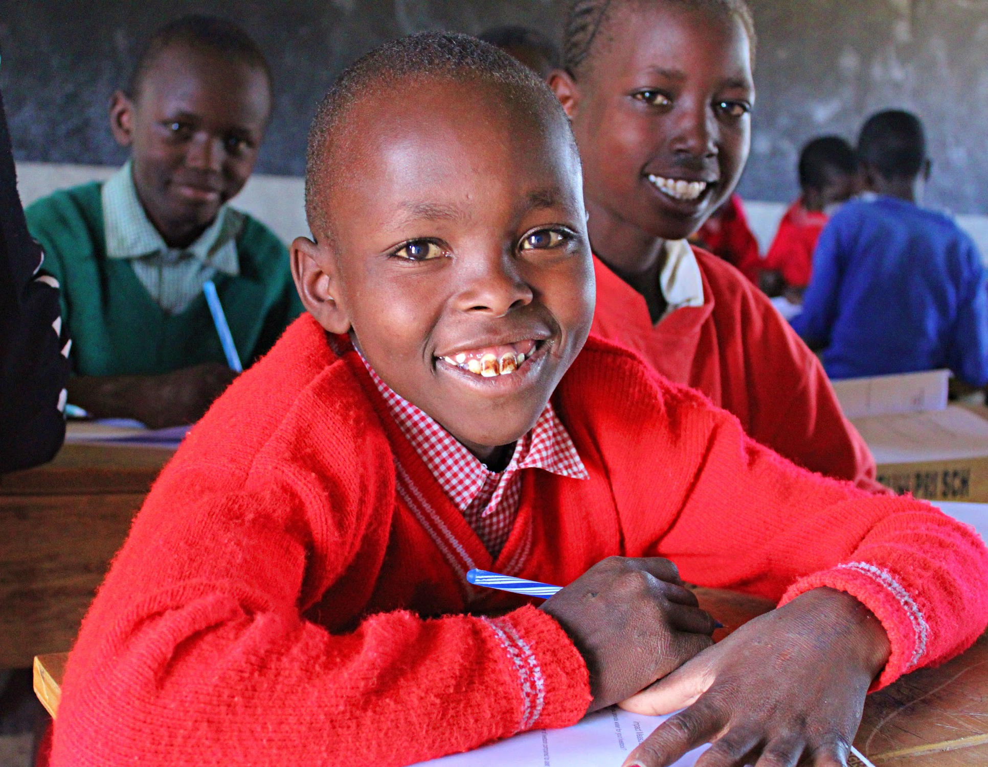
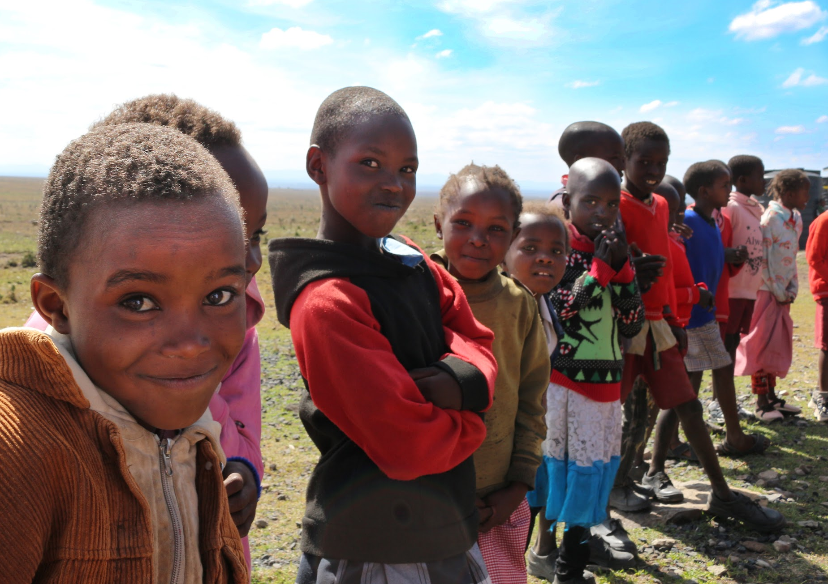
Notes:
https://wellawareworld.org/tangi-nyeusi/

Slide 19
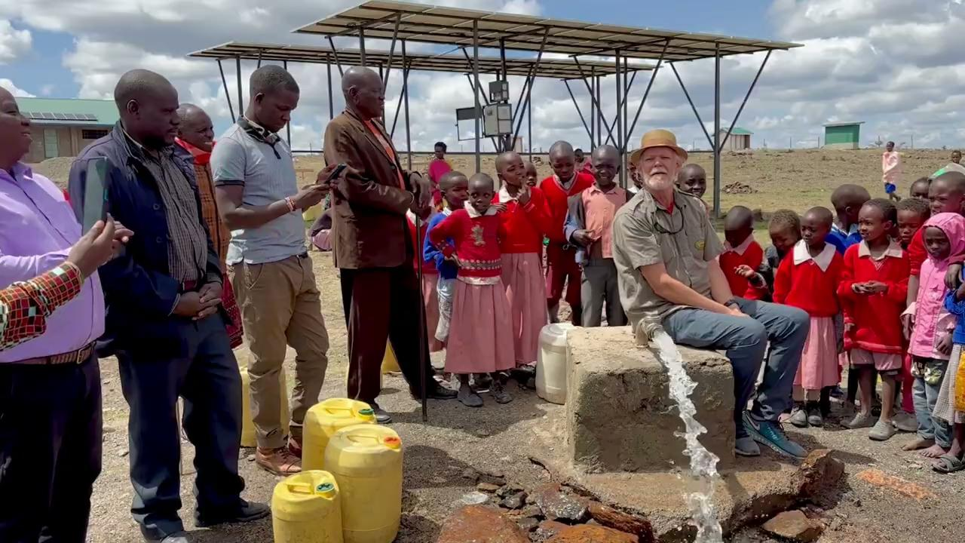
TANGI NYUESI, KENYA
Notes:
https://wellawareworld.org/tangi-nyeusi/

Slide 20
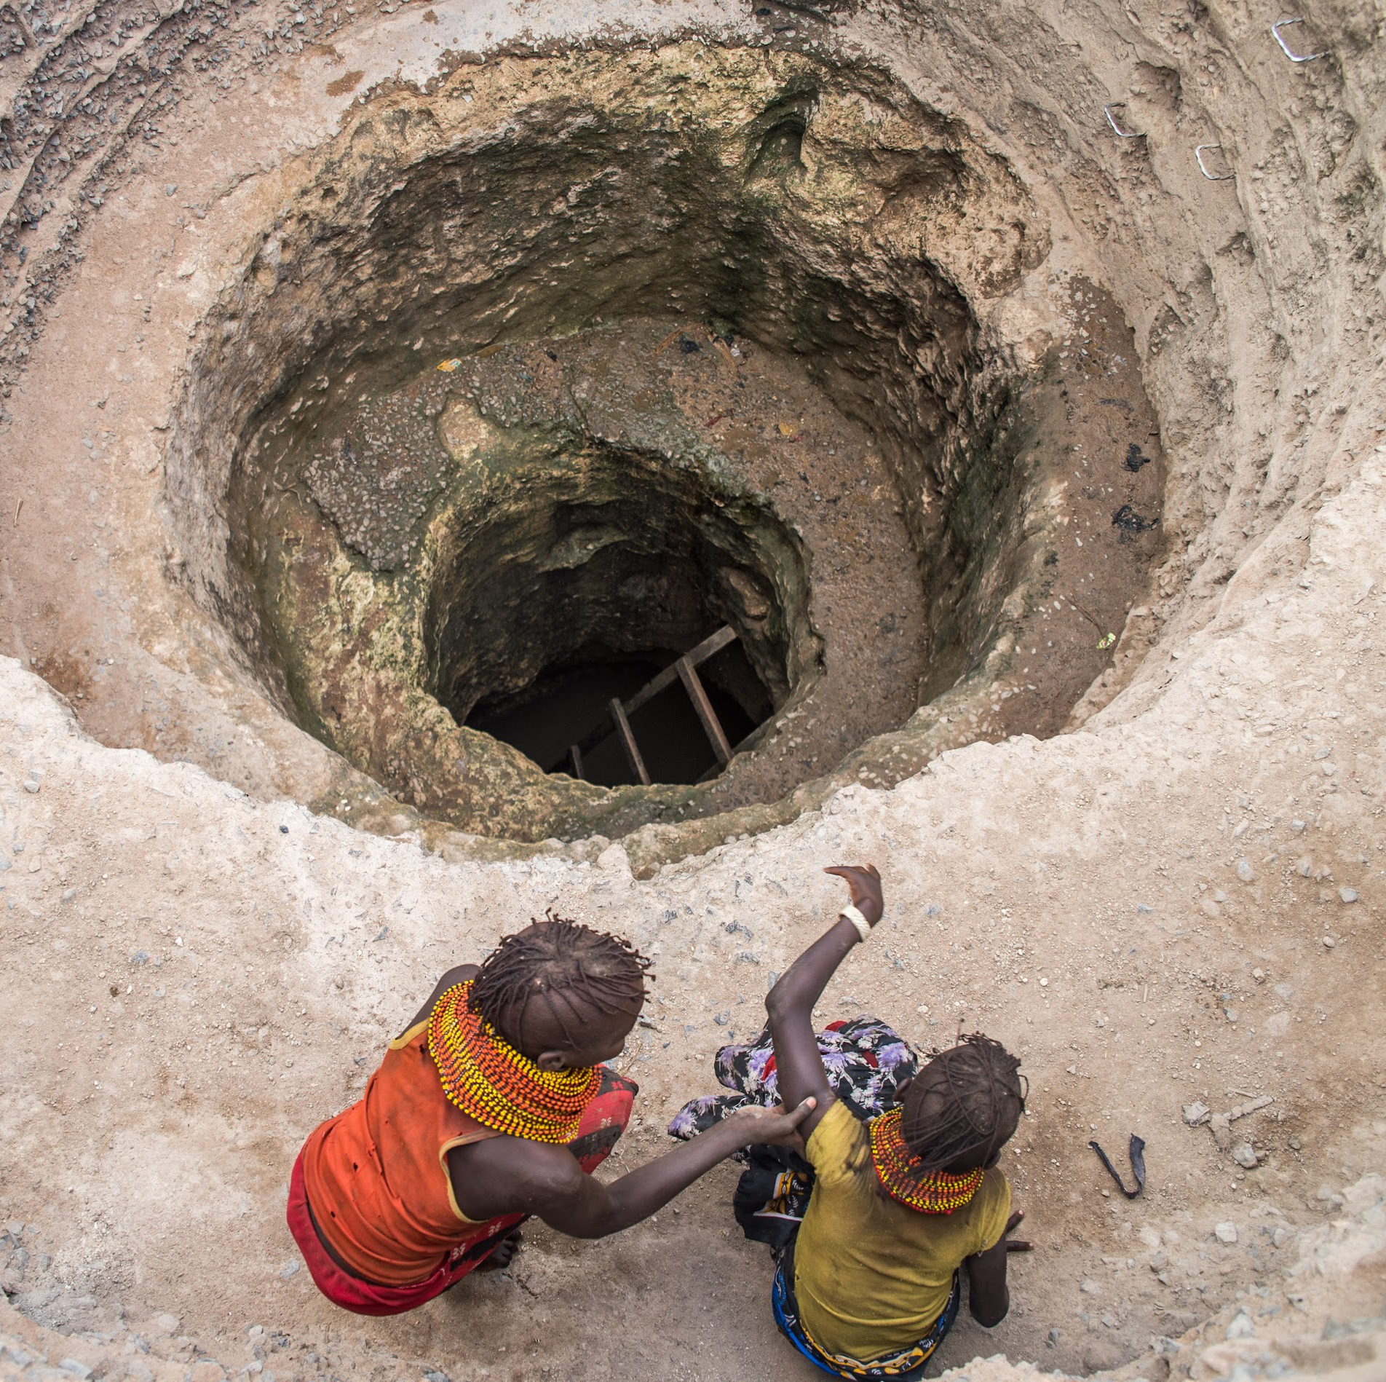
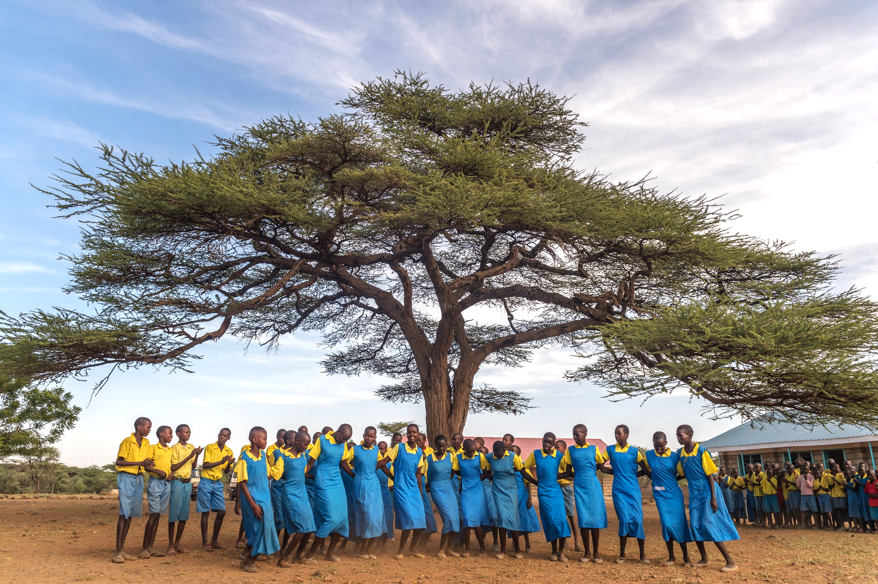
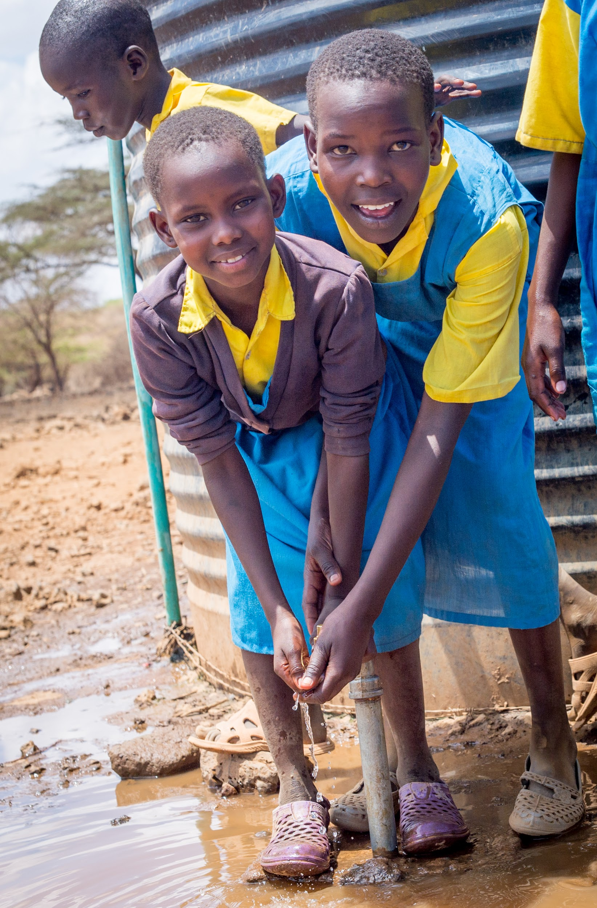
DAABA, KENYA
Notes:
https://wellawareworld.org/daabas-journey/

Slide 21
Notes:
https://wellawareworld.org/daabas-journey/

Slide 22
HOW YOU CAN HELP
Notes:
wellawareworld.org/water-project-news

Slide 23
EVERY $15
PROVIDES
1 PERSON WITH CLEAN WATER FOR LIFE.
Notes:
wellawareworld.org/give

Slide 24
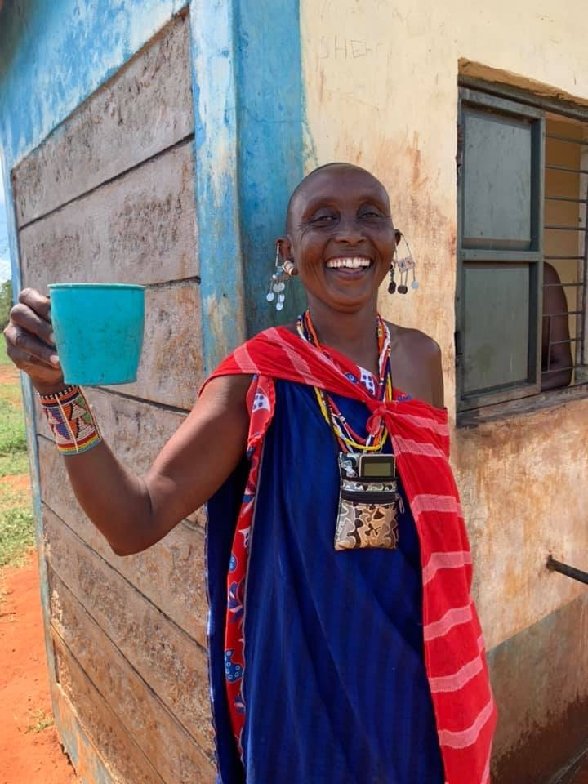
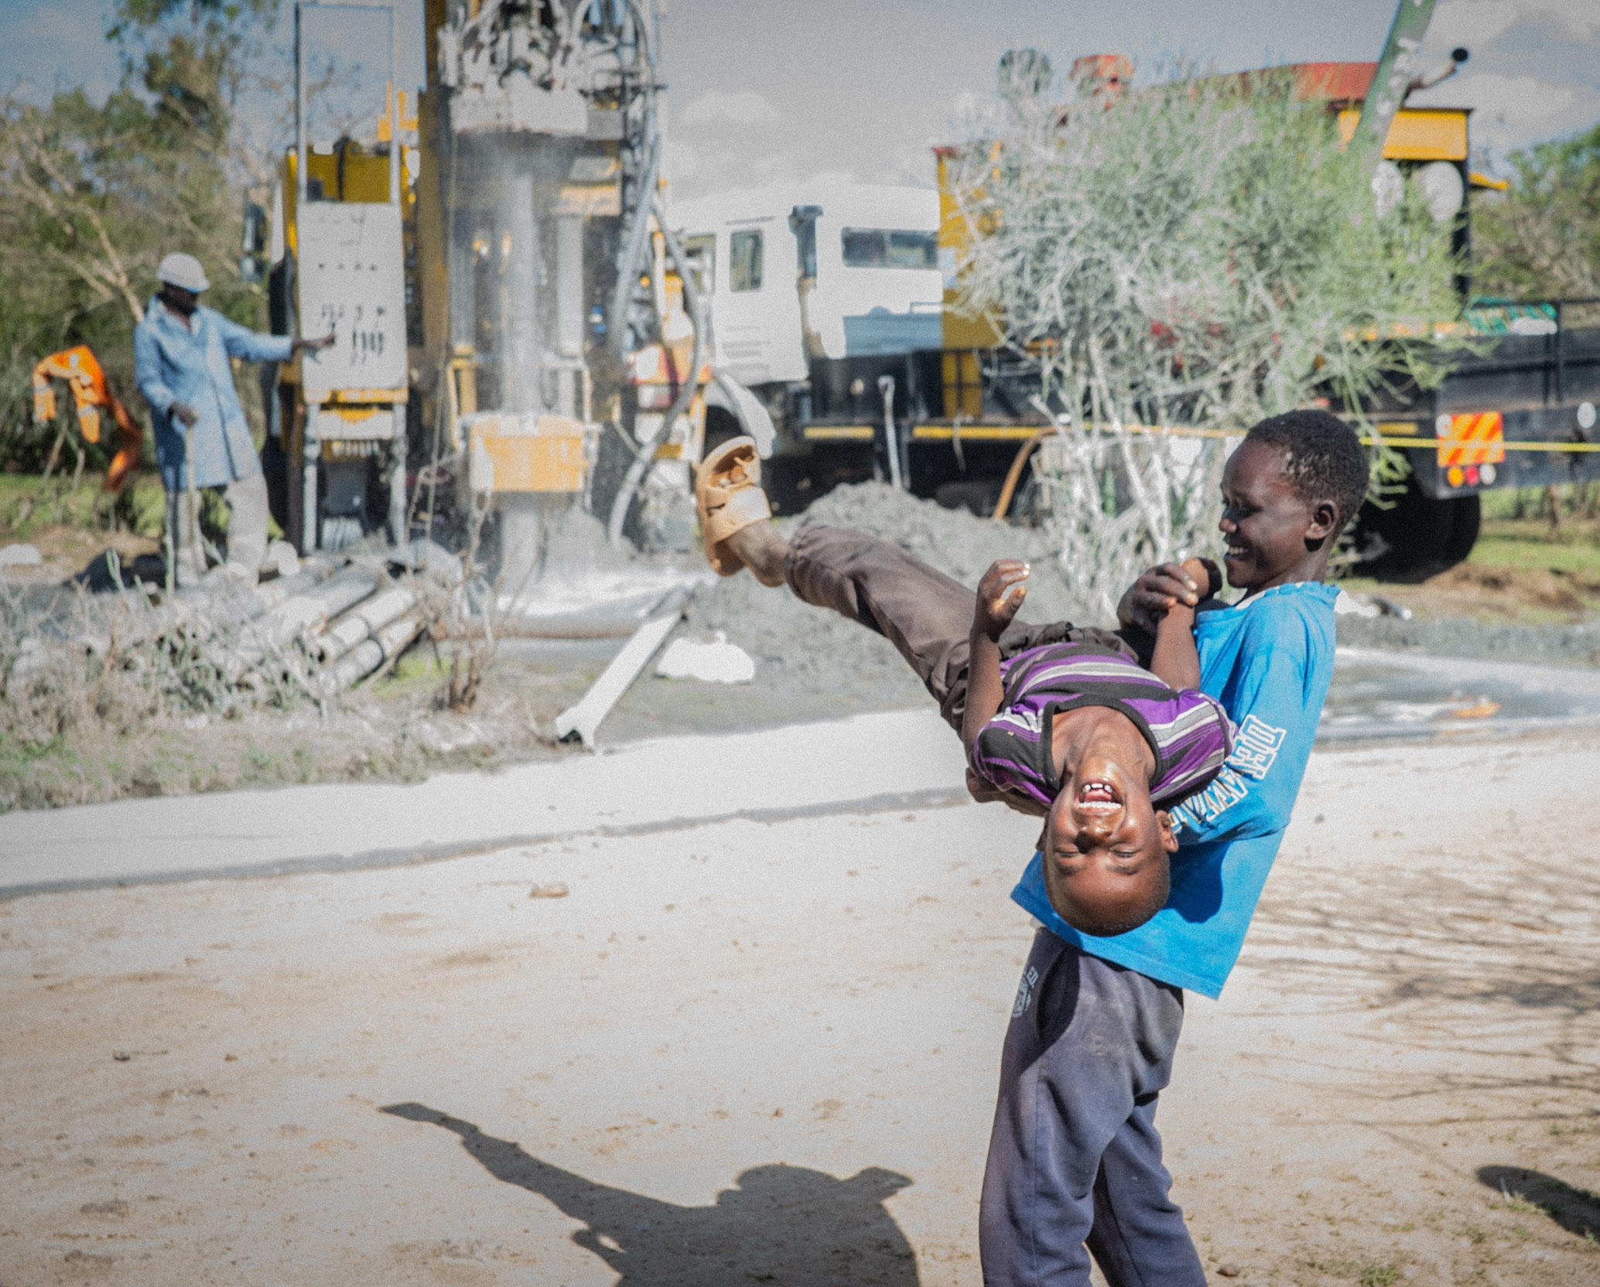
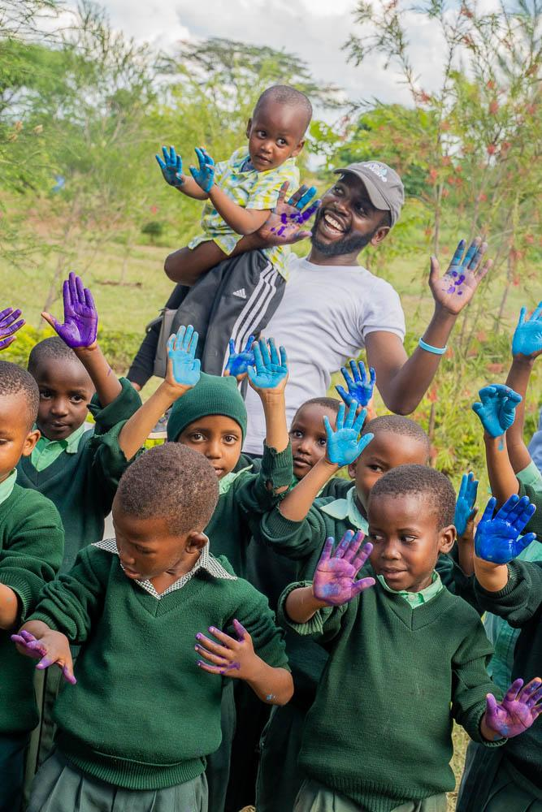
Notes:
https://wellawareworld.org/faces-of-water/

Slide 25
WAYS TO GET INVOLVED
Subscribe to our Newsletter
Donate Monthly through The Village
Spread Awareness About Our Mission
Join Shower Strike in April or Start Your Own Fundraiser
Get Your Company Involved by Becoming a Brand Partner
Notes:
https://wellawareworld.org/get-involved/

Slide 26
STAY CONNECTED
Sign Up for Our Newsletter: wellawareworld.org
Follow Us:
@WellAwareWorld

Slide 27
Q & A

Slide 28
THANK YOU!!

Slide 29
BOILERPLATE
Well Aware, an international 501(c)3 nonprofit organization headquartered in Austin, Texas, funds, implements, and maintains sustainable clean water systems in East Africa to drive development and empower communities to grow and thrive. Since 2010, all of Well Awareʼs 114+ projects maintain a 100% success rate—providing clean water to more than 350,000 people across Kenya and Tanzania. With their technical expertise and community-driven approach, Well Aware sets the standard for efficiency, innovation, and sustainability in the water aid sector.
To learn more, visit www.wellawareworld.org

